Slide 1
Graph Neural Networks: Models and Applications
Yao Ma, Wei Jin, Yiqi Wang and Jiliang Tang, Michigan State University
Tyler Derr, Vanderbilt University
Tutorial website: http://cse.msu.edu/~mayao4/tutorials/aaai2021/

Slide 2
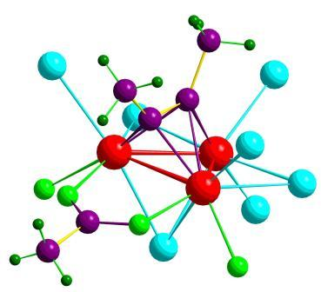
Data as Graphs - Explicit
Social Graphs
Transportation Graphs
Brain Graphs
Web Graphs
Molecular Graphs
Gene Graphs

Slide 3
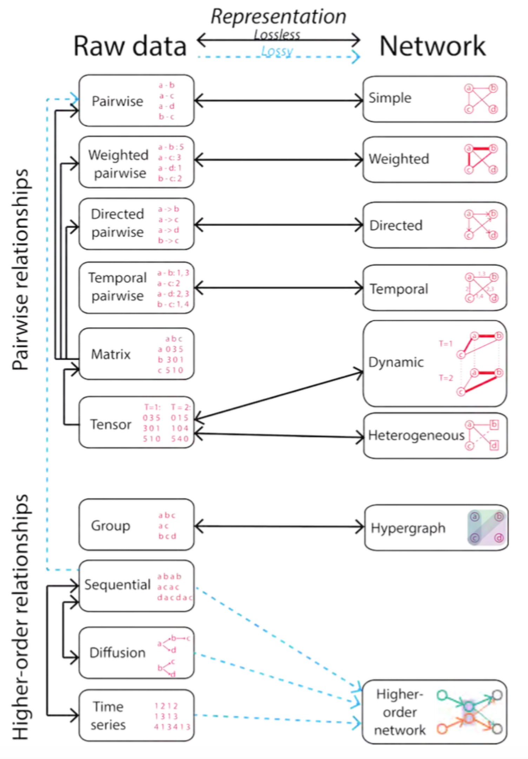

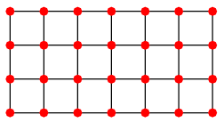
Data as Graphs - Implicit
Jian Xu. Representing Big Data as Networks. PhD Dissertation, University of Notre Dame

Slide 4
ML on Graphs
Numerous real-world problems can be summarized as a set of tasks on graphs
Link prediction
Node Classification
Community Detection
Ranking ….
ML solutions
Classification
Clustering
Traditional
i.i.d. data
Graphs
…..
Feature/Representation
Ranking
Notes:
Implicit → graph (image)
lattice graph
Feature/representation learning is the key. Not necessary can achieve the performance as traditional methods

Slide 5

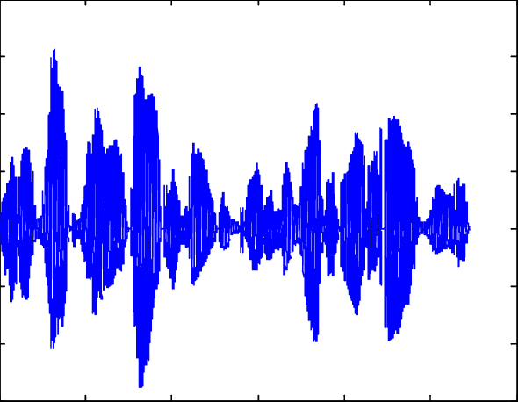
The Power of Deep Learning

Slide 6
Deep Learning Meets Graphs: Challenges
Traditional DL is designed for simple grids or sequences
CNNs for fixed-size images/grids
RNNs for text/sequences
But nodes on graphs have different connections
Arbitrary neighbor size
Complex topological structure
No fixed node ordering

Slide 7

Graph Neural Networks
Representations
Graph-level
Activation Function
Node-level
Graph Convolutions
Graph Convolutions

Slide 8
Tutorial Overview
Models
Foundations
Spectral-based GNN
Spatial-based GNN
Applications
Basic Graph Theory
Pooling Layers in GNN
Spectral Graph Theory
Robustness of GNN
Recommendations
Graph Fourier Analysis
Deeper GNN
Scalable Learning for GNN
Self-Supervised Learning for GNN

Slide 9
Two More Things

Slide 10
Book: Deep Learning on Graphs
https://cse.msu.edu/~mayao4/dlg_book/

Slide 11



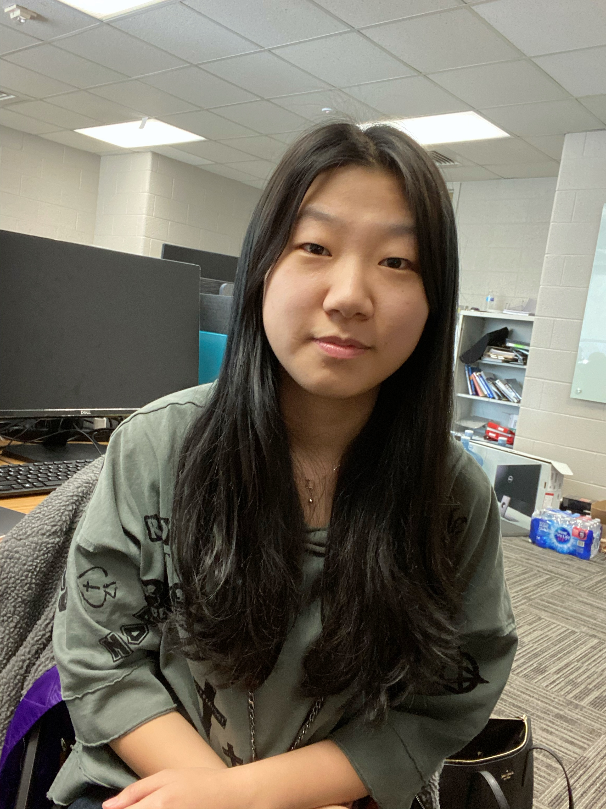

A Repository
GraphRobust: A repository about adversarial attacks and defenses on graph data
DeepRobust: A repository about general adversarial attacks and defenses

Slide 12
Tutorial Overview
Models
Foundations
Spectral-based GNN
Spatial-based GNN
Applications
Basic Graph Theory
Pooling Layers in GNN
Spectral Graph Theory
Robustness of GNN
Recommendations
Graph Fourier Analysis
Deeper GNN
Scalable Learning for GNN
Self-Supervised Learning for GNN

Slide 13
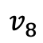
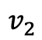
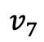
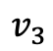
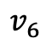
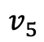
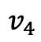
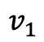
Graphs and Graph Signals
$$v_{7}$$
$$v_{8}$$
$$v_{1}$$
$$v_{3}$$
$$v_{6}$$
$$v_{5}$$
$$v_{2}$$
$$v_{4}$$

Slide 14
Graphs and Graph Signals
Graph Signal:

Slide 15
Graphs and Graph Signals
Graph Signal:

Slide 16
Graphs and Graph Signals
Graph Signal:

Slide 17
Matrix Representations of Graphs
$$v_{7}$$
$$v_{8}$$
$$v_{1}$$
$$v_{3}$$
$$v_{6}$$
$$v_{5}$$
$$v_{2}$$
$$v_{4}$$
Spectral graph theory. American Mathematical Soc.; 1997.

Slide 18
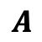
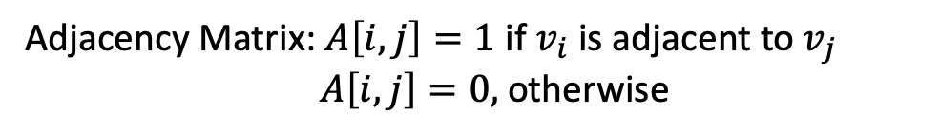
Matrix Representations of Graphs
$$v_{7}$$
$$v_{8}$$
$$v_{1}$$
$$v_{3}$$
Adjacency Matrix: $A\left[i,j\right]=1$ if $v_{i}$ is adjacent to $v_{j}$
$A\left[i,j\right]=0,$ otherwise
$$v_{6}$$
$$v_{5}$$
$$v_{2}$$
$$v_{4}$$
Adjacency Matrix
$$A$$
Spectral graph theory. American Mathematical Soc.; 1997.

Slide 19
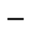

Matrix Representations of Graphs
$$v_{7}$$
$$v_{8}$$
$$v_{1}$$
$$v_{3}$$
Adjacency Matrix: $A\left[i,j\right]=1$ if $v_{i}$ is adjacent to $v_{j}$
$A\left[i,j\right]=0,$ otherwise
$$v_{6}$$
$$v_{5}$$
$$v_{2}$$
Degree Matrix:
$$v_{4}$$
Degree Matrix
Adjacency Matrix
$$−$$
$$D$$
$$A$$
Spectral graph theory. American Mathematical Soc.; 1997.

Slide 20
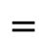
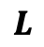
Matrix Representations of Graphs
$$v_{7}$$
$$v_{8}$$
$$v_{1}$$
$$v_{3}$$
Adjacency Matrix: $A\left[i,j\right]=1$ if $v_{i}$ is adjacent to $v_{j}$
$A\left[i,j\right]=0,$ otherwise
$$v_{6}$$
$$v_{5}$$
$$v_{2}$$
Degree Matrix:
$$v_{4}$$
Degree Matrix
Adjacency Matrix
Laplacian Matrix
$$−$$
$$=$$
$$D$$
$$A$$
$$L$$
Spectral graph theory. American Mathematical Soc.; 1997.

Slide 21
Laplacian Matrix as an Operator
Laplacian matrix is a difference operator:

Slide 22
Laplacian Matrix as an Operator
Laplacian matrix is a difference operator:

Slide 23
Laplacian Matrix as an Operator
Laplacian matrix is a difference operator:
Laplacian quadratic form:

Slide 24
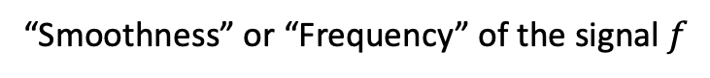
Laplacian Matrix as an Operator
Laplacian matrix is a difference operator:
Laplacian quadratic form:
“Smoothness” or “Frequency” of the signal $f$

Slide 25
Laplacian Matrix as an Operator
Laplacian matrix is a difference operator:
Low frequency graph signal
Laplacian quadratic form:
“Smoothness” or “Frequency” of the signal $f$

Slide 26
Laplacian Matrix as an Operator
Laplacian matrix is a difference operator:
Low frequency graph signal
Laplacian quadratic form:
“Smoothness” or “Frequency” of the signal $f$
High frequency graph signal

Slide 27
Eigen-decomposition of Laplacian Matrix
Laplacian matrix has a complete set of orthonormal eigenvectors:

Slide 28

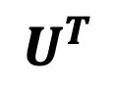
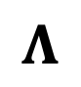
Eigen-decomposition of Laplacian Matrix
Laplacian matrix has a complete set of orthonormal eigenvectors:
$$U$$
$$Λ$$
$$U^{T}$$

Slide 29
Eigen-decomposition of Laplacian Matrix
Laplacian matrix has a complete set of orthonormal eigenvectors:
$$U$$
$$Λ$$
$$U^{T}$$
Eigenvalues are sorted non-decreasingly:

Slide 30
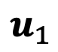
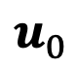
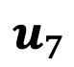
Eigenvectors as Graph Signals
$$u_{0}$$
$$u_{1}$$
$$u_{7}$$

Slide 31
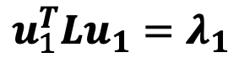
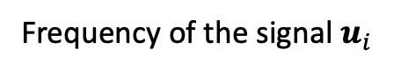
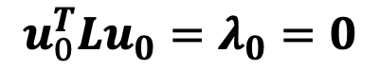
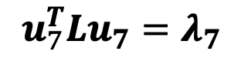
Eigenvectors as Graph Signals
The frequency of an eigenvector of Laplacian matrix is its corresponding eigenvalue:
Frequency of the signal $u_{i}$
$$u_{0}$$
$$u_{1}$$
$$u_{7}$$
$$u_{0}^{T}Lu_{0}=λ_{0}=0$$
$$u_{1}^{T}Lu_{1}=λ_{1}$$
$$u_{7}^{T}Lu_{7}=λ_{7}$$

Slide 32
Eigenvectors as Graph Signals
The frequency of an eigenvector of Laplacian matrix is its corresponding eigenvalue:
Frequency of the signal $u_{i}$
$$u_{0}$$
$$u_{1}$$
$$u_{7}$$
Low frequency
High frequency
$$u_{0}^{T}Lu_{0}=λ_{0}=0$$
$$u_{1}^{T}Lu_{1}=λ_{1}$$
$$u_{7}^{T}Lu_{7}=λ_{7}$$

Slide 33
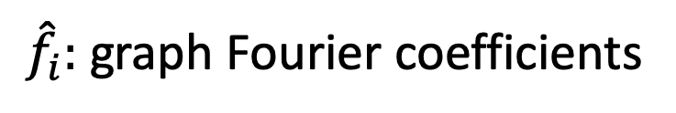
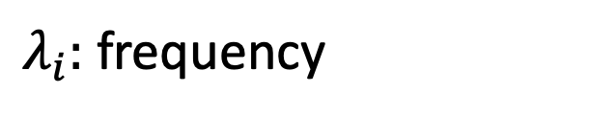
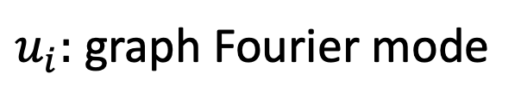
Graph Fourier Transform
A signal $f$ can be written as graph Fourier series:
$u_{i}:$ graph Fourier mode
$λ_{i}:$ frequency
${\hat{f}}_{i}:$ graph Fourier coefficients

Slide 34
Graph Fourier Transform
A signal $f$ can be written as graph Fourier series:
$u_{i}:$ graph Fourier mode
$λ_{i}:$ frequency
${\hat{f}}_{i}:$ graph Fourier coefficients

Slide 35
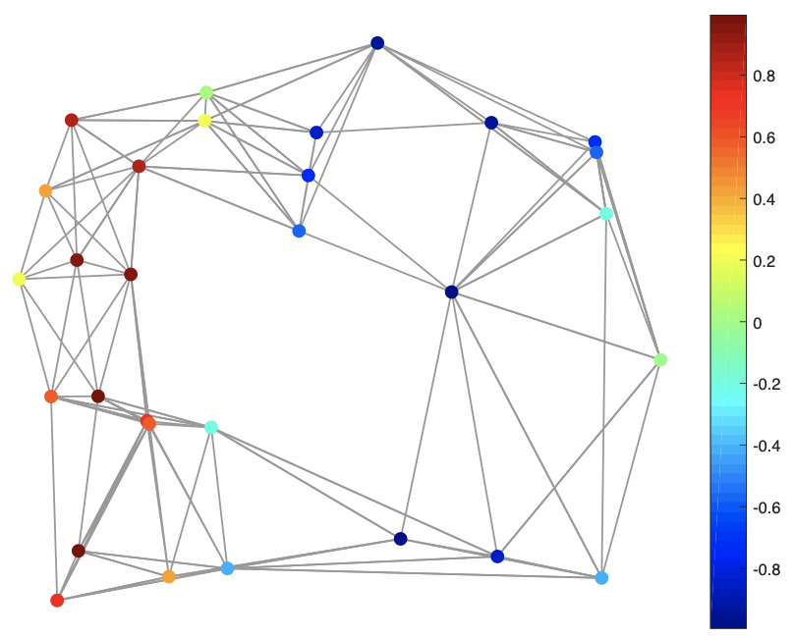
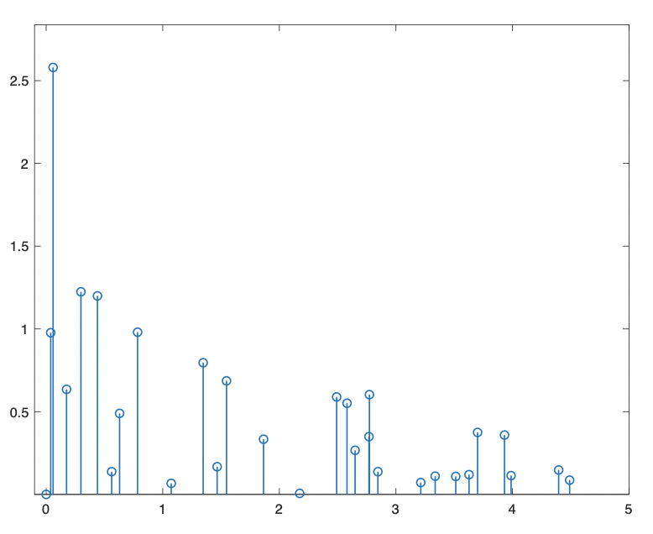
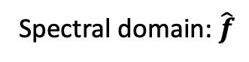
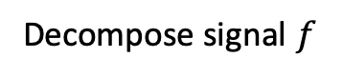
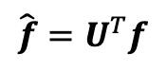
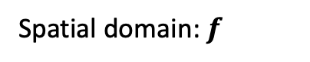
Graph Fourier Transform (GFT)
A signal $f$ can be written as graph Fourier series:
$u_{i}:$ graph Fourier mode
$λ_{i}:$ frequency
${\hat{f}}_{i}:$ graph Fourier coefficients
$$\hat{f}=U^{T}f$$
Decompose signal $f$
Spatial domain: $f$
Spectral domain: $\hat{f}$
The emerging field of signal processing on graphs: Extending high-dimensional data analysis to networks and other irregular domains. IEEE signal processing magazine

Slide 36
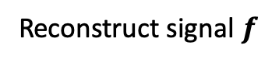
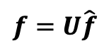
Inverse Graph Fourier Transform (IGFT)
A signal $f$ can be written as graph Fourier series:
$u_{i}:$ graph Fourier mode
$λ_{i}:$ frequency
${\hat{f}}_{i}:$ graph Fourier coefficients
$$f=U\hat{f}$$
Reconstruct signal $f$
Spatial domain: $f$
Spectral domain: $\hat{f}$

Slide 37
Tutorial Overview
Models
Foundations
Spectral-based GNN
Spatial-based GNN
Applications
Basic Graph Theory
Pooling Layers in GNN
Spectral Graph Theory
Robustness of GNN
Recommendations
Graph Fourier Analysis
Deeper GNN
Scalable Learning for GNN
Self-Supervised Learning for GNN

Slide 38
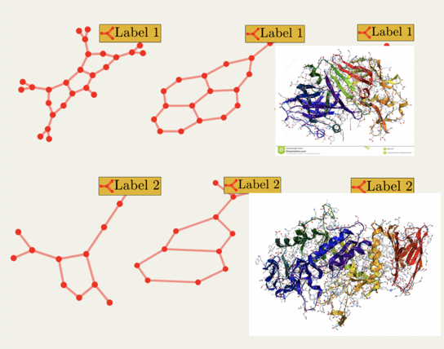
Tasks on Graph-Structured Data
Node-level
Graph-level
Link Prediction
Graph Classification
？
？
t
t+a
Node Classification
？
？
？

Slide 39
Tasks on Graph-Structured Data
Node-level
Graph-level

Slide 40
Tasks on Graph-Structured Data
Node-level
Graph-level
Node Representations

Slide 41
Tasks on Graph-Structured Data
Node-level
Graph-level
Node Representations
Graph Representation

Slide 42
Tasks on Graph-Structured Data
Node-level
Graph-level
Filtering
Pooling
Node Representations
Graph Representations

Slide 43
Two Main Operations in GNN
Graph Filtering
Graph Filtering

Slide 44
Two Main Operations in GNN
Graph Filtering
Graph Filtering

Slide 45
Two Main Operations in GNN
Graph Filtering
Graph Filtering
Graph filtering refines the node features

Slide 46
Two Main Operations in GNN
Graph Pooling
Graph Pooling

Slide 47
Two Main Operations in GNN
Graph Pooling
Graph Pooling

Slide 48
Two Main Operations in GNN
Graph Pooling
Graph Pooling
Graph pooling generates a smaller graph

Slide 49
General GNN Framework
For node-level tasks
Filtering Layer
Activation
…

Slide 50
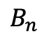
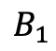
General GNN Framework
For graph-level tasks
Filtering Layer
Activation
Pooling Layer
…
…
…
$$B_{1}$$
$$B_{n}$$

Slide 51
Graph Filtering Operation
Graph Filtering

Slide 52
Two Types of Graph Filtering Operation
Spatial Based Filtering
Spectral Based Filtering
Original GNN
(Scarselli et al.
2005)
GraphSage
(Hamilton et al.
NIPS 2017)
Spectral
Graph CNN
(Bruna et al.
ICLR 2014)
GAT
(Veličković et al.
ICLR 2018)
GCN
(Kipf & Welling.
ICLR 2017)
MPNN
(Glimer et al.
ICML 2017)
ChebNet
(Defferard et al.
NIPS 2016)
…

Slide 53
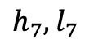
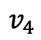
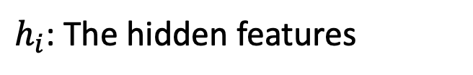
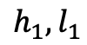
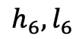
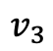
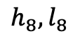
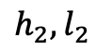










Graph Filtering in the First GNN Paper
$h_{i}$: The hidden features
$${h_{3},l}_{3}$$
$$v_{3}$$
$$v_{4}$$
$${h_{4},l}_{4}$$
$l_{i}$: The input features
$${h_{1},l}_{1}$$
$$v_{1}$$
$${h_{2},l}_{2}$$
$${h_{5},l}_{5}$$
$$v_{5}$$
$$v_{2}$$
$$v_{8}$$
$${h_{8},l}_{8}$$
$${h_{6},l}_{6}$$
$$v_{6}$$
$$v_{7}$$
$${h_{7},l}_{7}$$
Graph neural networks for ranking web pages. WI. IEEE, 2005.

Slide 54



Graph Filtering in the First GNN Paper
$h_{i}$: The hidden features
$${h_{3},l}_{3}$$
$$v_{3}$$
$$v_{4}$$
$${h_{4},l}_{4}$$
$l_{i}$: The input features
$${h_{1},l}_{1}$$
$$v_{1}$$
$${h_{2},l}_{2}$$
$${h_{5},l}_{5}$$
$$v_{5}$$
$$v_{2}$$
$$v_{8}$$
$${h_{8},l}_{8}$$
$${h_{6},l}_{6}$$
$$v_{6}$$
$$h_{i}^{(k+1)}=\sum_{v_{j}∈N(v_{i})}{f\left(l_{i},h_{j}^{(k)},l_{j}\right), ∀{ v}_{i}∈V.}$$
$$v_{7}$$
$${h_{7},l}_{7}$$
$N(v_{i}):$ Neighbors of the node $v_{i}$.
$f\left(⋅\right):$ Feedforward neural network.

Slide 55




Graph Spectral Filtering for Graph Signal
Recall:
$$GFT:\hat{f}=U^{T}f$$
$$IGFT:f=U\hat{f}$$
Filter a graph signal $f$:
$$f$$

Slide 56


Graph Spectral Filtering for Graph Signal
Recall:
$$GFT:\hat{f}=U^{T}f$$
$$IGFT:f=U\hat{f}$$
Filter a graph signal $f$:
$$f$$
$$GFT$$
$$u_{i}^{T}f$$
Decompose
Coefficients

Slide 57



Graph Spectral Filtering for Graph Signal
Recall:
$$GFT:\hat{f}=U^{T}f$$
$$IGFT:f=U\hat{f}$$
Filter a graph signal $f$:
$$f$$
$$GFT$$
$$u_{i}^{T}f$$
$$\hat{g}(λ_{i})$$
$$\hat{g}\left(λ_{i}\right)⋅u_{i}^{T}f$$
Decompose
Filter
Coefficients
Filtered coefficients
Filter $\hat{g}\left(λ_{i}\right):$ Modulating the frequency

Slide 58

Graph Spectral Filtering for Graph Signal
Recall:
$$GFT:\hat{f}=U^{T}f$$
$$IGFT:f=U\hat{f}$$
Filter a graph signal $f$:
$$f$$
$$GFT$$
$$u_{i}^{T}f$$
$$\hat{g}(λ_{i})$$
$$\hat{g}\left(λ_{i}\right)⋅u_{i}^{T}f$$
Decompose
Filter
Coefficients
Filtered coefficients
Example:
Filter $\hat{g}\left(λ_{i}\right):$ Modulating the frequency
$$\hat{g}$$
$$\hat{g}$$
$$\hat{g}$$
$$λ_{i}$$
$$λ_{i}$$
$$λ_{i}$$

Slide 59


Graph Spectral Filtering for Graph Signal
Recall:
$$GFT:\hat{f}=U^{T}f$$
$$IGFT:f=U\hat{f}$$
Filter a graph signal $f$:
$$GFT$$
$$\hat{g}(λ_{i})$$
$$IGFT$$
$$\sum_{i=0}^{N−1}{\hat{g}\left(λ_{i}\right)⋅u_{i}^{T}f⋅u_{i}}$$
$$f$$
$$u_{i}^{T}f$$
$$\hat{g}\left(λ_{i}\right)⋅u_{i}^{T}f$$
Decompose
Filter
Reconstruct
Coefficients
Filtered coefficients
Example:
Filter $\hat{g}\left(λ_{i}\right):$ Modulating the frequency
$$\hat{g}$$
$$\hat{g}$$
$$\hat{g}$$
$$λ_{i}$$
$$λ_{i}$$
$$λ_{i}$$

Slide 60





Graph Spectral Filtering for Graph Signal
Recall:
$$GFT:\hat{f}=U^{T}f$$
$$IGFT:f=U\hat{f}$$
Filter a graph signal $f$:
$$GFT$$
$$\hat{g}(Λ)$$
$$IGFT$$
$$U{\hat{g}(Λ)U}^{T}f$$
$$f$$
$$U^{T}f$$
$${\hat{g}(Λ)U}^{T}f$$
Decompose
Filter
Reconstruct
Coefficients
Filtered coefficients
Example:
$$\hat{g}$$
$$\hat{g}$$
$$\hat{g}$$
$$λ_{i}$$
$$λ_{i}$$
$$λ_{i}$$

Slide 61

Graph Spectral Filtering for Graph Signal
Recall:
$$GFT:\hat{f}=U^{T}f$$
$$IGFT:f=U\hat{f}$$
Filter a graph signal $f$:
$$GFT$$
$$\hat{g}(Λ)$$
$$IGFT$$
$$U{\hat{g}(Λ)U}^{T}f$$
$$f$$
$$U^{T}f$$
$${\hat{g}(Λ)U}^{T}f$$
Decompose
Filter
Reconstruct
Coefficients
Filtered coefficients
$$\hat{g}(L)$$
Example:
$$\hat{g}$$
$$\hat{g}$$
$$\hat{g}$$
$$λ_{i}$$
$$λ_{i}$$
$$λ_{i}$$

Slide 62


Graph Spectral Filtering for Graph Signal
Recall:
$$GFT:\hat{f}=U^{T}f$$
$$IGFT:f=U\hat{f}$$
Filter a graph signal $f$:
$$GFT$$
$$\hat{g}(Λ)$$
$$IGFT$$
$$U{\hat{g}(Λ)U}^{T}f$$
$$f$$
$$U^{T}f$$
$${\hat{g}(Λ)U}^{T}f$$
Decompose
Filter
Reconstruct
Coefficients
Filtered coefficients
$$\hat{g}(L)$$
$$f$$
$$\hat{g}(L)f$$
Filtering

Slide 63
Graph Spectral Filtering for GNN
How to design the filter?

Slide 64

Graph Spectral Filtering for GNN
How to design the filter?
Data-driven! Learn $\hat{g}(Λ)$ from data!

Slide 65

Graph Spectral Filtering for GNN
How to design the filter?
Data-driven! Learn $\hat{g}(Λ)$ from data!
How to deal with multi-channel signals?
$F_{in}∈ℝ^{N×d_{1}}→F_{out}∈ℝ^{N×d_{2}}$.

Slide 66
Graph Spectral Filtering for GNN
How to design the filter?
Data-driven! Learn $\hat{g}(Λ)$ from data!
How to deal with multi-channel signals?
$F_{in}∈ℝ^{N×d_{1}}→F_{out}∈ℝ^{N×d_{2}}$.
Each input channel contributes to each output channel

Slide 67

Graph Spectral Filtering for GNN
How to design the filter?
Data-driven! Learn $\hat{g}(Λ)$ from data!
How to deal with multi-channel signals?
$F_{in}∈ℝ^{N×d_{1}}→F_{out}∈ℝ^{N×d_{2}}$.
Each input channel contributes to each output channel
$$F_{out}\left[:,i\right]=\sum_{j=1}^{d_{1}}{{\hat{g}}_{ij}\left(L\right)F_{in}\left[:,j\right] i=1,…d_{2}}$$
Filter each input channel

Slide 68

Graph Spectral Filtering for GNN
How to design the filter?
Data-driven! Learn $\hat{g}(Λ)$ from data!
How to deal with multi-channel signals?
$F_{in}∈ℝ^{N×d_{1}}→F_{out}∈ℝ^{N×d_{2}}$.
Each input channel contributes to each output channel
$$F_{out}\left[:,i\right]=\sum_{j=1}^{d_{1}}{{\hat{g}}_{ij}\left(L\right)F_{in}\left[:,j\right] i=1,…d_{2}}$$
Learn $d_{2}×d_{1}$ filters
Filter each input channel

Slide 69

$\hat{g}(Λ)$: Non-parametric

Slide 70

$\hat{g}(Λ)$: Non-parametric
Spectral Networks and Locally Connected Networks on Graphs. ICLR 2014

Slide 71

$\hat{g}(Λ)$: Non-parametric
$d_{2}×d_{1}×N$ parameters

Slide 72

$\hat{g}(Λ)$: Non-parametric
$d_{2}×d_{1}×N$ parameters
$$U{\hat{g}(Λ)U}^{T}f$$
Expensive eigen-decomposition

Slide 73


$\hat{g}(Λ)$ : Polynomial Parametrized
Convolutional Neural Networks on Graphs with Fast Localized Spectral Filtering. NIPS 2016.

Slide 74

$\hat{g}(Λ)$ : Polynomial Parametrized
$d_{2}×d_{1}×K$ parameters

Slide 75

$\hat{g}(Λ)$ : Polynomial Parametrized
$d_{2}×d_{1}×K$ parameters
$$U\hat{g}\left(Λ\right)U^{T}f=\sum_{k=0}^{K}{θ_{k}L^{k}}f$$

Slide 76
$\hat{g}(Λ)$ : Polynomial Parametrized
$d_{2}×d_{1}×K$ parameters
$$U\hat{g}\left(Λ\right)U^{T}f=\sum_{k=0}^{K}{θ_{k}L^{k}}f$$
No eigen-decomposition needed

Slide 77
Polynomial Parametrized Filter: a Spatial View

Slide 78

Polynomial Parametrized Filter: a Spatial View
If the node $v_{j}$ is more than $K$-hops away from node $v_{i}$, then,

Slide 79
Polynomial Parametrized Filter: a Spatial View
If the node $v_{j}$ is more than $K$-hops away from node $v_{i}$, then,
The filter is localized within $K$-hops neighbors in the spatial domain

Slide 80
Chebyshev Polynomials
The polynomials adopted have non-orthogonal basis $1, x, x^{2}, x^{3},…$

Slide 81
Chebyshev Polynomials
The polynomials adopted have non-orthogonal basis $1, x, x^{2}, x^{3},…$
Unstable under perturbation of coefficients

Slide 82
Chebyshev Polynomials
The polynomials adopted have non-orthogonal basis $1, x, x^{2}, x^{3},…$
Unstable under perturbation of coefficients
Chebyshev polynomials:

Slide 83

Chebyshev Polynomials
The polynomials adopted have non-orthogonal basis $1, x, x^{2}, x^{3},…$
Unstable under perturbation of coefficients
Chebyshev polynomials:
Recursive definition:
$T_{0}\left(x\right)=1;T_{1}\left(x\right)=x$
$T_{k}\left(x\right)=2xT_{k−1}\left(x\right)−T_{k−2}(x)$

Slide 84

Chebyshev Polynomials
The polynomials adopted have non-orthogonal basis $1, x, x^{2}, x^{3},…$
Unstable under perturbation of coefficients
Chebyshev polynomials:
Recursive definition:
$T_{0}\left(x\right)=1;T_{1}\left(x\right)=x$
$T_{k}\left(x\right)=2xT_{k−1}\left(x\right)−T_{k−2}(x)$
The Chebyshev polynomials $\left\{T_{k}\right\}$ form an orthogonal basis for the Hilbert space $L^{2}(\left[−1,1\right],\frac{dy}{\sqrt{1−y^{2}}})$.

Slide 85
Chebyshev Polynomials
The polynomials adopted have non-orthogonal basis $1, x, x^{2}, x^{3},…$
Unstable under perturbation of coefficients
Chebyshev polynomials:
Recursive definition:
$T_{0}\left(x\right)=1;T_{1}\left(x\right)=x$
$T_{k}\left(x\right)=2xT_{k−1}\left(x\right)−T_{k−2}(x)$
The Chebyshev polynomials $\left\{T_{k}\right\}$ form an orthogonal basis for the Hilbert space $L^{2}(\left[−1,1\right],\frac{dy}{\sqrt{1−y^{2}}})$.

Slide 86

ChebNet
Parametrize $\hat{g}(Λ)$ with Chebyshev polynomials
Convolutional Neural Networks on Graphs with Fast Localized Spectral Filtering. NIPS 2016.

Slide 87
ChebNet
Parametrize $\hat{g}(Λ)$ with Chebyshev polynomials
$d_{2}×d_{1}×K$ parameters

Slide 88

ChebNet
Parametrize $\hat{g}(Λ)$ with Chebyshev polynomials
$d_{2}×d_{1}×K$ parameters
$U\hat{g}\left(Λ\right)U^{T}f=\sum_{k=0}^{K}{θ_{k}T_{k}(\tilde{L})}f$, with $\tilde{L}=\frac{2L}{λ_{max}}−I$
No eigen-decomposition needed

Slide 89
ChebNet
Parametrize $\hat{g}(Λ)$ with Chebyshev polynomials
$d_{2}×d_{1}×K$ parameters
$U\hat{g}\left(Λ\right)U^{T}f=\sum_{k=0}^{K}{θ_{k}T_{k}(\tilde{L})}f$, with $\tilde{L}=\frac{2L}{λ_{max}}−I$
No eigen-decomposition needed
Stable under perturbation of coefficients

Slide 90
GCN: Simplified ChebNet
Use Chebyshev polynomials with $K=1$ and assume $λ_{max}=2$
Semi-Supervised Classification with Graph Convolutional Networks. ICLR 2017.

Slide 91

GCN: Simplified ChebNet
Use Chebyshev polynomials with $K=1$ and assume $λ_{max}=2$
Further constrain ${θ=θ}_{0}=−θ_{1}$

Slide 92
GCN: Simplified ChebNet
Use Chebyshev polynomials with $K=1$ and assume $λ_{max}=2$
Further constrain ${θ=θ}_{0}=−θ_{1}$
Apply a renormalization trick

Slide 93

GCN for Multi-channel Signal
Recall:
$$F_{out}\left[:,i\right]=\sum_{j=1}^{d_{1}}{{\hat{g}}_{ij}\left(L\right)F_{in}\left[:,j\right] i=1,…d_{2}}$$
Filter each input channel

Slide 94

GCN for Multi-channel Signal
Recall:
$$F_{out}\left[:,i\right]=\sum_{j=1}^{d_{1}}{{\hat{g}}_{ij}\left(L\right)F_{in}\left[:,j\right] i=1,…d_{2}}$$
Filter each input channel
For GCN:
$$F_{out}\left[:,i\right]=\sum_{j=1}^{d_{1}}{θ_{ji}{(\tilde{D}}^{−\frac{1}{2}}\tilde{A}{\tilde{D}}^{−\frac{1}{2}})F_{in}\left[:,j\right] i=1,…d_{2}}$$
GCN filter

Slide 95

GCN for Multi-channel Signal
Recall:
$$F_{out}\left[:,i\right]=\sum_{j=1}^{d_{1}}{{\hat{g}}_{ij}\left(L\right)F_{in}\left[:,j\right] i=1,…d_{2}}$$
Filter each input channel
For GCN:
$$F_{out}\left[:,i\right]=\sum_{j=1}^{d_{1}}{θ_{ji}{(\tilde{D}}^{−\frac{1}{2}}\tilde{A}{\tilde{D}}^{−\frac{1}{2}})F_{in}\left[:,j\right] i=1,…d_{2}}$$
GCN filter
In matrix form:
$$F_{out}= {(\tilde{D}}^{−\frac{1}{2}}\tilde{A}{\tilde{D}}^{−\frac{1}{2}})F_{in}Θ \text{with} Θ∈ℝ^{d_{1}×d_{2}} and Θ\left[j,i\right]=θ_{ji}$$

Slide 96

















A Spatial View of GCN Filter
Denote $C={\tilde{D}}^{−\frac{1}{2}}\tilde{A}{\tilde{D}}^{−\frac{1}{2}}$
$$F[3,:]$$
$$v_{3}$$
$$v_{4}$$
$$F[4,:]$$
$$F[1,:]$$
$$v_{1}$$
$$F[2,:]$$
$$F[5,:]$$
$$v_{5}$$
$$v_{2}$$
$$v_{8}$$
$$F[8,:]$$
$$F[6,:]$$
$$v_{6}$$
$$v_{7}$$
$$F[7,:]$$

Slide 97


A Spatial View of GCN Filter
Denote $C={\tilde{D}}^{−\frac{1}{2}}\tilde{A}{\tilde{D}}^{−\frac{1}{2}}$
Then $F_{out}=$ ${CF}_{in}Θ$
For node $v_{i},$ ${ F}_{out}\left[i,:\right]=\sum_{j}{C\left[i,j\right]F_{in}\left[j,:\right]Θ}$
$$F[3,:]$$
$$v_{3}$$
$$v_{4}$$
$$F[4,:]$$
$$F[1,:]$$
$$v_{1}$$
$$F[2,:]$$
$$F[5,:]$$
$$v_{5}$$
$$v_{2}$$
$$v_{8}$$
$$F[8,:]$$
$$F[6,:]$$
$$v_{6}$$
$$v_{7}$$
$$F[7,:]$$

Slide 98

A Spatial View of GCN Filter
Denote $C={\tilde{D}}^{−\frac{1}{2}}\tilde{A}{\tilde{D}}^{−\frac{1}{2}}$
Then $F_{out}=$ ${CF}_{in}Θ$
For node $v_{i},$ ${ F}_{out}\left[i,:\right]=\sum_{j}{C\left[i,j\right]F_{in}\left[j,:\right]Θ}$
$$F[3,:]$$
Observe that:
$$v_{3}$$
$$F[4,:]$$
$$v_{4}$$
$$F[1,:]$$
$C[i,j]=0$ for $v_{j}∉N\left(v_{i}\right)∪\left\{v_{i}\right\}$
$$v_{1}$$
$$F[2,:]$$
$$F[5,:]$$
$$v_{5}$$
$$v_{2}$$
$$v_{8}$$
$$F[8,:]$$
$$F[6,:]$$
$$v_{6}$$
$$v_{7}$$
$$F[7,:]$$

Slide 99
A Spatial View of GCN Filter
Denote $C={\tilde{D}}^{−\frac{1}{2}}\tilde{A}{\tilde{D}}^{−\frac{1}{2}}$
Then $F_{out}=$ ${CF}_{in}Θ$
For node $v_{i},$ ${ F}_{out}\left[i,:\right]=\sum_{j}{C\left[i,j\right]F_{in}\left[j,:\right]Θ}$
$$F[3,:]$$
Observe that:
$$v_{3}$$
$$F[4,:]$$
$$v_{4}$$
$$F[1,:]$$
$C[i,j]=0$ for $v_{j}∉N\left(v_{i}\right)∪\left\{v_{i}\right\}$
$$v_{1}$$
$$F[2,:]$$
$$F[5,:]$$
$$v_{5}$$
$$v_{2}$$
$$v_{8}$$
$$F[8,:]$$
$$F[6,:]$$
Hence,
$$v_{6}$$
$$v_{7}$$
$$F[7,:]$$

Slide 100
A Spatial View of GCN Filter
Denote $C={\tilde{D}}^{−\frac{1}{2}}\tilde{A}{\tilde{D}}^{−\frac{1}{2}}$
Then $F_{out}=$ ${CF}_{in}Θ$
For node $v_{i},$ ${ F}_{out}\left[i,:\right]=\sum_{j}{C\left[i,j\right]F_{in}\left[j,:\right]Θ}$
$$F[3,:]$$
Observe that:
$$v_{3}$$
$$F[4,:]$$
$$v_{4}$$
$$F[1,:]$$
$C[i,j]=0$ for $v_{j}∉N\left(v_{i}\right)∪\left\{v_{i}\right\}$
$$v_{1}$$
$$F[2,:]$$
$$F[5,:]$$
$$v_{5}$$
$$v_{2}$$
$$v_{8}$$
$$F[8,:]$$
$$F[6,:]$$
Hence,
$$v_{6}$$
$$v_{7}$$
$$F[7,:]$$
Feature transformation

Slide 101
A Spatial View of GCN Filter
Denote $C={\tilde{D}}^{−\frac{1}{2}}\tilde{A}{\tilde{D}}^{−\frac{1}{2}}$
Then $F_{out}=$ ${CF}_{in}Θ$
For node $v_{i},$ ${ F}_{out}\left[i,:\right]=\sum_{j}{C\left[i,j\right]F_{in}\left[j,:\right]Θ}$
$$F[3,:]$$
Observe that:
$$v_{3}$$
$$F[4,:]$$
$$v_{4}$$
$$F[1,:]$$
$C[i,j]=0$ for $v_{j}∉N\left(v_{i}\right)∪\left\{v_{i}\right\}$
$$v_{1}$$
$$F[2,:]$$
$$F[5,:]$$
$$v_{5}$$
$$v_{2}$$
$$v_{8}$$
$$F[8,:]$$
$$F[6,:]$$
Hence,
$$v_{6}$$
$$v_{7}$$
$$F[7,:]$$
Feature transformation
Aggregation

Slide 102















Filter in GCN VS Filter in the First GNN
GCN: k-th layer
$${h_{3},l}_{3}$$
$$v_{3}$$
$$v_{4}$$
$${h_{4},l}_{4}$$
$${h_{1},l}_{1}$$
$$v_{1}$$
$${h_{2},l}_{2}$$
$${h_{5},l}_{5}$$
The first GNN: k-th layer
$$v_{5}$$
$$v_{2}$$
$$v_{8}$$
$${h_{8},l}_{8}$$
$${h_{6},l}_{6}$$
$$v_{6}$$
$$v_{7}$$
$${h_{7},l}_{7}$$

Slide 103
Filter in GCN VS Filter in the First GNN
GCN: k-th layer
$${h_{3},l}_{3}$$
$$v_{3}$$
$$v_{4}$$
$${h_{4},l}_{4}$$
$${h_{1},l}_{1}$$
$$v_{1}$$
$${h_{2},l}_{2}$$
$${h_{5},l}_{5}$$
The first GNN: k-th layer
$$v_{5}$$
$$v_{2}$$
$$v_{8}$$
$${h_{8},l}_{8}$$
$${h_{6},l}_{6}$$
$$v_{6}$$
$$v_{7}$$
$${h_{7},l}_{7}$$

Slide 104
Filter in GCN VS Filter in the First GNN
GCN: k-th layer
$${h_{3},l}_{3}$$
$$v_{3}$$
$$v_{4}$$
$${h_{4},l}_{4}$$
$${h_{1},l}_{1}$$
$$v_{1}$$
$${h_{2},l}_{2}$$
$${h_{5},l}_{5}$$
The first GNN: k-th layer
$$v_{5}$$
$$v_{2}$$
$$v_{8}$$
$${h_{8},l}_{8}$$
$${h_{6},l}_{6}$$
$$v_{6}$$
$$v_{7}$$
$${h_{7},l}_{7}$$

Slide 105
Filter in GraphSage
Neighbor Sampling
$${h_{3},l}_{3}$$
$$v_{3}$$
$$v_{4}$$
$${h_{4},l}_{4}$$
$${h_{1},l}_{1}$$
$$v_{1}$$
$${h_{2},l}_{2}$$
$${h_{5},l}_{5}$$
$$v_{5}$$
$$v_{2}$$
$$v_{8}$$
$${h_{8},l}_{8}$$
$${h_{6},l}_{6}$$
$$v_{6}$$
$$v_{7}$$
$${h_{7},l}_{7}$$
Inductive Representation Learning on Large Graphs. NIPS 2017.

Slide 106
Filter in GraphSage
Neighbor Sampling
$${h_{3},l}_{3}$$
$$v_{3}$$
$$v_{4}$$
$${h_{4},l}_{4}$$
$${h_{1},l}_{1}$$
Aggregation
$$v_{1}$$
$${h_{2},l}_{2}$$
$${h_{5},l}_{5}$$
$$v_{5}$$
$$v_{2}$$
$$v_{8}$$
$${h_{8},l}_{8}$$
$${h_{6},l}_{6}$$
$$v_{6}$$
$$v_{7}$$
$${h_{7},l}_{7}$$

Slide 107


Filter in GAT
$${h_{3},l}_{3}$$
$$v_{3}$$
$$v_{4}$$
$${h_{4},l}_{4}$$
$${h_{1},l}_{1}$$
$$v_{1}$$
$${h_{2},l}_{2}$$
$${h_{5},l}_{5}$$
$$v_{5}$$
$$v_{2}$$
$$v_{8}$$
$${h_{8},l}_{8}$$
$${h_{6},l}_{6}$$
$$v_{6}$$
$$v_{7}$$
$${h_{7},l}_{7}$$
Graph Attention Networks. ICLR 2018.

Slide 108



Filter in GAT
$${h_{3},l}_{3}$$
$$v_{3}$$
$$v_{4}$$
$${h_{4},l}_{4}$$
$$α_{13}$$
$${h_{1},l}_{1}$$
$$v_{1}$$
$$α_{15}$$
$${h_{2},l}_{2}$$
$$α_{18}$$
$${h_{5},l}_{5}$$
$$v_{5}$$
$$v_{2}$$
$$v_{8}$$
$${h_{8},l}_{8}$$
$${h_{6},l}_{6}$$
$$v_{6}$$
$$v_{7}$$
$${h_{7},l}_{7}$$

Slide 109

Filter in MPNN
Message Passing
$${h_{3},l}_{3}$$
$$v_{3}$$
$$v_{4}$$
$${h_{4},l}_{4}$$
$${h_{1},l}_{1}$$
$$v_{1}$$
Feature Updating
$${h_{2},l}_{2}$$
$${h_{5},l}_{5}$$
$$v_{5}$$
$$v_{2}$$
$$v_{8}$$
$${h_{8},l}_{8}$$
$${h_{6},l}_{6}$$
$$v_{6}$$
$$v_{7}$$
$${h_{7},l}_{7}$$
$M_{k}()$ and $U_{k}()$ are functions to be designed
Neural Message Passing for Quantum Chemistry. ICML 2017.

Slide 110
UGNN: A Unified Framework
Filtering Operations
GCN
GAT
Graph Signal Denoising
PPNP
APPNP
…
A Unified View on Graph Neural Networks as Graph Signal Denosing. arXiv, 2020.

Slide 111
Graph Pooling Operation
Graph Pooling

Slide 112




gPool
Downsample by selecting the most importance nodes
$${h_{3},l}_{3}$$
$$v_{3}$$
$$v_{4}$$
$${h_{4},l}_{4}$$
$${h_{1},l}_{1}$$
$$v_{1}$$
$${h_{2},l}_{2}$$
$${h_{5},l}_{5}$$
$$v_{5}$$
$$v_{2}$$
$$v_{8}$$
$${h_{8},l}_{8}$$
$${h_{6},l}_{6}$$
$$v_{6}$$
$$v_{7}$$
$${h_{7},l}_{7}$$
Graph U-Nets. ICML 2019.

Slide 113


gPool
Downsample by selecting the most importance nodes
Importance Measure
$${h_{3},l}_{3}$$
$$y_{i}=\frac{h_{i}^{T}p}{||p||}$$
$$v_{3}$$
$$v_{4}$$
$${h_{4},l}_{4}$$
$$v_{i}→y_{i}$$
$${h_{1},l}_{1}$$
$$v_{1}$$
$${h_{2},l}_{2}$$
$${h_{5},l}_{5}$$
$$v_{5}$$
$$v_{2}$$
$$v_{8}$$
$${h_{8},l}_{8}$$
$${h_{6},l}_{6}$$
$$v_{6}$$
$$v_{7}$$
$${h_{7},l}_{7}$$

Slide 114


gPool
Downsample by selecting the most importance nodes
Importance Measure
$${h_{3},l}_{3}$$
$$y_{i}=\frac{h_{i}^{T}p}{||p||}$$
$$v_{3}$$
$$v_{4}$$
$${h_{4},l}_{4}$$
$$v_{i}→y_{i}$$
$${h_{1},l}_{1}$$
$$v_{1}$$
Select top the $n_{p}$ nodes
$${h_{2},l}_{2}$$
$${h_{5},l}_{5}$$
$$idx=rank(y,n_{p})$$
$$v_{5}$$
$$v_{2}$$
$$v_{8}$$
$${h_{8},l}_{8}$$
$${h_{6},l}_{6}$$
$$v_{6}$$
$$v_{7}$$
$${h_{7},l}_{7}$$

Slide 115



gPool
Downsample by selecting the most importance nodes
Importance Measure
$${h_{3},l}_{3}$$
$$y_{i}=\frac{h_{i}^{T}p}{||p||}$$
$$v_{3}$$
$$v_{4}$$
$${h_{4},l}_{4}$$
$$v_{i}→y_{i}$$
$${h_{1},l}_{1}$$
$$v_{1}$$
Select top the $n_{p}$ nodes
$${h_{2},l}_{2}$$
$${h_{5},l}_{5}$$
$$idx=rank(y,n_{p})$$
$$v_{5}$$
$$v_{2}$$
$$v_{8}$$
$${h_{8},l}_{8}$$
$${h_{6},l}_{6}$$
Generate $A_{p}$ and intermediate $H_{inter}$
$$v_{6}$$
$$v_{7}$$
$$A_{p}=A[idx,idx]$$
$${h_{7},l}_{7}$$
$$H_{inter}=H[idx,:]$$

Slide 116



gPool
Downsample by selecting the most importance nodes
Importance Measure
$${h_{3},l}_{3}$$
$$y_{i}=\frac{h_{i}^{T}p}{||p||}$$
$$v_{3}$$
$$v_{4}$$
$${h_{4},l}_{4}$$
$$v_{i}→y_{i}$$
$${h_{1},l}_{1}$$
$$v_{1}$$
Select top the $n_{p}$ nodes
$${h_{2},l}_{2}$$
$${h_{5},l}_{5}$$
$$idx=rank(y,n_{p})$$
$$v_{5}$$
$$v_{2}$$
$$v_{8}$$
$${h_{8},l}_{8}$$
$${h_{6},l}_{6}$$
Generate $A_{p}$ and intermediate $H_{inter}$
$$v_{6}$$
$$v_{7}$$
$$A_{p}=A[idx,idx]$$
$${h_{7},l}_{7}$$
$$H_{inter}=H[idx,:]$$
Generate $H_{p}$
$$\tilde{y}=sigmoid(y\left[idx\right])$$
$$H_{p}=H_{inter}⊙\tilde{y}$$

Slide 117
DiffPool
Downsample by clustering the nodes using GNN
$${h_{3},l}_{3}$$
$$v_{3}$$
$$v_{4}$$
$${h_{4},l}_{4}$$
$${h_{1},l}_{1}$$
$$v_{1}$$
$${h_{2},l}_{2}$$
$${h_{5},l}_{5}$$
$$v_{5}$$
$$v_{2}$$
$$v_{8}$$
$${h_{8},l}_{8}$$
$${h_{6},l}_{6}$$
$$v_{6}$$
$$v_{7}$$
$${h_{7},l}_{7}$$
Hierarchical Graph Representation Learning with Differentiable Pooling. NeurIPS 2018.

Slide 118








DiffPool
Downsample by clustering the nodes using GNN
2 filters
$${h_{a}}_{3}$$
$$v_{3}$$
$$v_{4}$$
$${h_{a}}_{4}$$
$${h_{a}}_{1}$$
Filter1:
$$v_{1}$$
Generate a soft-assign matrix
$${h_{a}}_{2}$$
$${h_{a}}_{5}$$
$$v_{5}$$
$$v_{2}$$
$$v_{8}$$
$${h_{a}}_{8}$$
$${h_{a}}_{6}$$
$$v_{6}$$
$$v_{7}$$
$${h_{a}}_{7}$$

Slide 119
DiffPool
Downsample by clustering the nodes using GNN
2 filters
$${h_{a}}_{3}$$
$$v_{3}$$
$$v_{4}$$
$${h_{a}}_{4}$$
$${h_{a}}_{1}$$
Filter1:
$$v_{1}$$
Generate a soft-assign matrix
$${h_{a}}_{2}$$
$${h_{a}}_{5}$$
$$v_{5}$$
$$v_{2}$$
$$v_{8}$$
$${h_{a}}_{8}$$
$${h_{a}}_{6}$$
$$v_{6}$$
$$v_{7}$$
$${h_{a}}_{7}$$
Filter2:
Generate new features

Slide 120
DiffPool
Downsample by clustering the nodes using GNN
$${h_{a}}_{3}$$
Generated soft-assign matrix
$$v_{3}$$
$$v_{4}$$
$${h_{a}}_{4}$$
$${h_{a}}_{1}$$
$$v_{1}$$
Generated new features
$${h_{a}}_{2}$$
$${h_{a}}_{5}$$
$$v_{5}$$
$$v_{2}$$
$$v_{8}$$
$${h_{a}}_{8}$$
$${h_{a}}_{6}$$
$$v_{6}$$
$$v_{7}$$
$${h_{a}}_{7}$$

Slide 121

DiffPool
Downsample by clustering the nodes using GNN
$${h_{a}}_{3}$$
Generated soft-assign matrix
$$v_{3}$$
$$v_{4}$$
$${h_{a}}_{4}$$
$${h_{a}}_{1}$$
$$v_{1}$$
Generated new features
$${h_{a}}_{2}$$
$${h_{a}}_{5}$$
$$v_{5}$$
$$v_{2}$$
$$v_{8}$$
$${h_{a}}_{8}$$
$${h_{a}}_{6}$$
Generate $A_{p}$
$$v_{6}$$
$$v_{7}$$
$${h_{a}}_{7}$$

Slide 122

DiffPool
Downsample by clustering the nodes using GNN
$${h_{a}}_{3}$$
Generated soft-assign matrix
$$v_{3}$$
$$v_{4}$$
$${h_{a}}_{4}$$
$${h_{a}}_{1}$$
$$v_{1}$$
Generated new features
$${h_{a}}_{2}$$
$${h_{a}}_{5}$$
$$v_{5}$$
$$v_{2}$$
$$v_{8}$$
$${h_{a}}_{8}$$
$${h_{a}}_{6}$$
Generate $A_{p}$
$$v_{6}$$
$$v_{7}$$
$${h_{a}}_{7}$$
Generate $H_{p}$

Slide 123
Eigenpooling
$${h_{3},l}_{3}$$
$$v_{3}$$
$$v_{4}$$
$${h_{4},l}_{4}$$
$${h_{1},l}_{1}$$
$$v_{1}$$
$${h_{2},l}_{2}$$
$${h_{5},l}_{5}$$
$$v_{5}$$
$$v_{2}$$
$$v_{8}$$
$${h_{8},l}_{8}$$
$${h_{6},l}_{6}$$
$$v_{6}$$
$$v_{7}$$
$${h_{7},l}_{7}$$
Graph Convolutional Networks with EigenPooling. KDD 2019.

Slide 124

Eigenpooling
$${h_{3},l}_{3}$$
Learn $A_{p}$ using clustering methods
$$v_{3}$$
$$v_{4}$$
$${h_{4},l}_{4}$$
$${h_{1},l}_{1}$$
$$v_{1}$$
$${h_{2},l}_{2}$$
$${h_{5},l}_{5}$$
$$v_{5}$$
$$v_{2}$$
$$v_{8}$$
$${h_{8},l}_{8}$$
$${h_{6},l}_{6}$$
$$v_{6}$$
$$v_{7}$$
$${h_{7},l}_{7}$$

Slide 125

Eigenpooling
$${h_{3},l}_{3}$$
Learn $A_{p}$ using clustering methods
$$v_{3}$$
$$v_{4}$$
$${h_{4},l}_{4}$$
$${h_{1},l}_{1}$$
$$v_{1}$$
$${h_{2},l}_{2}$$
$${h_{5},l}_{5}$$
$$v_{5}$$
$$v_{2}$$
$${h_{8},l}_{8}$$
$${h_{6},l}_{6}$$
Focus on learning better $H_{p}$
$$v_{8}$$
$$v_{6}$$
$$v_{7}$$
$${h_{7},l}_{7}$$

Slide 126
Eigenpooling
$${h_{3},l}_{3}$$
Learn $A_{p}$ using clustering methods
$$v_{3}$$
$$v_{4}$$
$${h_{4},l}_{4}$$
$${h_{1},l}_{1}$$
$$v_{1}$$
$${h_{2},l}_{2}$$
$${h_{5},l}_{5}$$
$$v_{5}$$
$$v_{2}$$
$${h_{8},l}_{8}$$
$${h_{6},l}_{6}$$
Focus on learning better $H_{p}$
$$v_{8}$$
$$v_{6}$$
$$v_{7}$$
$${h_{7},l}_{7}$$
Capture both feature and graph structure

Slide 127




Going Back to Graph Spectral Theory
Recall:
$$\hat{f}=U^{T}f$$
Decompose signal $f$
Spatial domain: $f$
Spectral domain: $\hat{f}$

Slide 128
Going Back to Graph Spectral Theory
Do we need all the coefficients to reconstruct a “good” signal?

Slide 129
Going Back to Graph Spectral Theory
Do we need all the coefficients to reconstruct a “good” signal?

Slide 130
Going Back to Graph Spectral Theory
Do we need all the coefficients to reconstruct a “good” signal?

Slide 131
Eigenpooling: Truncated Fourier Coefficients
Eigenvectors (Fourier Modes) of the subgraph

Slide 132
Eigenpooling: Truncated Fourier Coefficients
Eigenvectors (Fourier Modes) of the subgraph
GFT
Fourier coefficients

Slide 133
Eigenpooling: Truncated Fourier Coefficients
Eigenvectors (Fourier Modes) of the subgraph
GFT
Fourier coefficients
Truncated Fourier coefficients

Slide 134
Eigenpooling: Truncated Fourier Coefficients
Eigenvectors (Fourier Modes) of the subgraph
GFT
Fourier coefficients
Truncated Fourier coefficients
New features for the subgraph (a node in the smaller graph)

Slide 135
Robustness of GNN
Notes:
Hi everyone, I am Yiqi, a PhD student from Michigan State University. It’s my great pleasure to be here with you. My lab mate, Yao, has just given a great introduction about the foundation of Graph and Graph Neural Network. Next, I am going to talk about the robustness of GNN, a very interesting topic which has drawn great attention in the field of data mining and machine learning.

Slide 136






Adversarial Attacks on Deep Learning
Classified as panda
$$x$$
Small adversarial noise
$$ε$$
Classified as gibbon
$$x′$$
Find $x’$ satisfying $\left|\left|x^{′}−x\right|\right|≤Δ$
such that $C\left(x^{′}\right)≠y$
Notes:
Let’s get started from a toy example. As we all know, deep neural network are vulnerable to adversarial attacks. Here we have a picture of panda x, which is correctly classified as panda by the convolutional network. However, if we add some small adversarial noise, epsilon, to picture, although to us humans, this is still a panda. But the neural network is fooled and classifies the picture as gibbon. So the goal of adversarial attack can be formulated as follows, we try to find x’ satisfying the difference between x’ and x is smaller than delta, such that the predicted class of x’ is no longer the true label.

Slide 137
Do Graph Neural Networks Suffer the Same Problem?
Notes:
Then the question comes, since graph neural network is an extension of convolutional neural network, does it face the same problem?

Slide 138
Adversarial Attacks on GNN
5
6
5
6
4
772
4
772
1
3
1
3
8
8
2
2
GNN
GNN
8
Predicted as:
8
Predicted as:
Notes:
The answer is Yes. Here we have a graph, which contains 6 blue nodes and 2 green nodes. And the GNN successfully predicted node 7 as green. But if we add some adversarial noise to the graph, that is we connect node 8 with a blue node 5, It is a small change on the graph. But we find that the GCN gives the wrong prediction. Which means GNN are also vulnerable to adversarial attacks.

Slide 139



Consequences
Financial Systems
Credit Card Fraud Detection
Recommender Systems
Social Recommendation
Product Recommendation
….
772
8
Notes:
Then you may ask why is this problem important? Yeah, actually we don’t care about this toy example. But what if the graph is a credit card transaction graph and node 7 and 8 are the fraudsters. The GNN model aims to find which nodes are fraudsters. However, the fraudster can connect with some other high-credit users to disguise himself and escape from the detection of the gnn model.
The adversarial attacks can also harm recommender systems, like social recommendation, product recommendation and etc. In the rest of the presentation, I will divide the speech into two parts, the popular attacking methods and how do we defend against the attacks. For developing attacking methods, you might wonder if we can directly apply existing methods of adversarial attacks on image domain. The answer is no.

Slide 140



Image vs Graph
Discreteness
Perturbation Measure
Perturbation Type
F
A
E
C
B
D
Notes:
For the attacking methods, there are already a lot of work studying adversarial attacks on image data, can we directly apply the existing solutions to generate attacks?
Unfortunately, we cannot. There are several main differences between graph data and image data.
The first one is discreteness. We know the pixel values in image data are continuous, but here the adjacency matrix which represent the graph is discrete, which makes it hard to directly apply continuous methods, such as gradient decedent.
The second difference is perturbation measure. Adversarial attacks should be small and unnoticeable. For image data, we human can easily define if two images are similar or not. But for graphs, the comparison is much more difficult. Both the graph structure and node features can vary. it is hard to define whether two graphs are similar or not.
Last but not least, in graph, there are much more perturbation types than that in imgae.

Slide 141
Perturbation Type
6
5
6
5
4
772
4
772
3
1
3
6
1
5
8
8
2
2
4
772
Adding an edge
Rewiring
1
3
8
2
5
6
5
6
4
772
4
7
3
Modifying Features
3
1
1
8
8
2
2
9
Deleting an edge
Node Injection
Notes:
In a graph, we can easily add an new edge between two disconnected nodes; likewise, we can also delete an existing edge between two connected nodes. This perturbation type is called adding or deleting an edge. In addition, we can delete one existing edge between two nodes, and then connect one of them with the third node. This is called “rewiring”. Another common perturbation type is “node injection”, where we create a new node in a graph, and connect it with other nodes. It’s like that we create an new user account in social network, such as facebook or twitter, and connect this fake user with other users to perturb the whole social network. The operations we mentioned so far are all perturbations related to graph structure. Actually we can also perturb a graph by modifying node features.

Slide 142



Evasion & Poisoning Attack
Evasion Attack
Poisoning Attack
5
6
6
5
6
5
6
$$Perturb
5
 Perturb
4
772
4
4
772
4
772
3
3
772
3
1
3
1
1
1
8
2
8
2
8
2
8
2
 Train
 Train
$$Test
$$Test
Trained GNN
Trained GNN
Notes:
Except for perturbation types, we can also have some other categories on graph attacks. Here we can also divide graph attacks into evasion attack and poisoning attack based on the attacker ‘capacity. If the attacker is only capable of inserting adversarial perturbation in the test stage, which in other words, the attacker is not capable of changing the model parameters or structures, the attack is called evasion attack; However, if the attack happens before the training process，as shown in the right part of the picture, it is called a poisoning attack.

Slide 143
Targeted & Non-Targeted
Targeted Attack
Non-Targeted Attack
5
6
6
5
4
772
4
3
772
1
1
3
8
8
2
2
8
Target Node
Notes:
Also, we can divide the attacks into two groups based on whether the attacker has specific targeted nodes. As shown in the slide, for targets attack, the attackers target on misclassifying a given small set of test nodes. While for non-targets attack, the attackers aim to reduce the overall performance of of the trained model on the whole test set.

Slide 144
Attack Methods
Attack Methods | Injecting Node | Adding /Deleting Edge | Rewiring | Modifying Features | Evasion | Poisoning | Targeted | Non-Targeted
Grad-Argmax | ✓ | ✓ |  | ✓ | ✓ | ✓ | ✓ | ✓
Nettack |  | ✓ |  | ✓ | ✓ | ✓ | ✓
GF-Attack |  | ✓ |  |  | ✓ |  | ✓
ReWatt |  |  | ✓ |  | ✓ |  |  | ✓
RL-S2V |  | ✓ |  |  | ✓ |  | ✓
Meta-Attack |  | ✓ |  |  |  | ✓ |  | ✓
NIPA | ✓ |  |  |  |  | ✓ |  | ✓
Notes:
Since we have covered the categories of different attack, we list some representative algorithms and categorize them into this table. Due to the time constraint, we only choose four of them to elaborate.

Slide 145
Attack Methods
Attack Methods | Injecting Node | Adding /Deleting Edge | Rewiring | Modifying Features | Evasion | Poisoning | Targeted | Non-Targeted
Grad-Argmax | ✓ | ✓ |  | ✓ | ✓ | ✓ | ✓ | ✓
Notes:
First of all, Let’s take a look at the Grad-argmax algorithm.

Slide 146

GradArgmax
Our Goal:
$$\arg{\max_{\hat{A},\hat{X}}{\sum_{u∈V_{t}}{ℓ\left(f_{θ^{∗}}{\left(\hat{A},\hat{X}\right)}_{u},y_{u} \right)}}}$$
$$s.t. θ^{∗}=\arg{\min_{θ}{ℒ(f_{θ}\left(A^{′},X′\right))}}$$
$$\left|\hat{A}−A\right|+\left|\hat{X}−X\right|<Δ$$
Adversarial Attack on Graph Structured Data. ICML 2018.
Adversarial Attacks on Neural Networks for Graph Data. KDD 2018
Notes:
The basic idea of gradargmax is to find the perturbation on adjacent matrix and feature matrix to maximize the difference between the predicted label of targeted nodes and the corresponding ground truth label, while the perturbation changes are constrained to be smaller that delta. Here theta star denotes the optimized parameters of GNN trained on A prime and X prime, where the A prime and X prime can be the original adjacent matrix and feature matrix or the perturbed adjacent matrix and feature matrix.

Slide 147


GradArgmax
Our Goal:
$$\arg{\max_{\hat{A},\hat{X}}{\sum_{u∈V_{t}}{ℓ\left(f_{θ^{∗}}{\left(\hat{A},\hat{X}\right)}_{u},y_{u}\right)}}}$$
$$s.t. θ^{∗}=\arg{\min_{θ}{ℒ(f_{θ}\left(A^{′},X′\right))}}$$
$$\left|\hat{A}−A\right|+\left|\hat{X}−X\right|<Δ$$
Perturbations
Modifications on $A, X$
Evasion: $A^{′}=A, X^{′}=X$
Poisoning: $A^{′}=\hat{A}, X^{′}=\hat{X}$
Non-Targeted: $V_{t}=V_{all}$
Targeted: $V_{t}$ is a small subset
Notes:
According to the attack category we have just introduced, we can adjust GradArgmax into different categories with different implementations. Specifically we can perform perturbations only on A or X if we want to only change either the graph structure or the node features.

Slide 148

GradArgmax
Our Goal:
$$\arg{\max_{\hat{A},\hat{X}}{\sum_{u∈V_{t}}{ℓ\left(f_{θ^{∗}}{\left(\hat{A},\hat{X}\right)}_{u},y_{u}\right)}}}$$
$$s.t. θ^{∗}=\arg{\min_{θ}{ℒ(f_{θ}\left(A^{′},X′\right))}}$$
$$\left|\hat{A}−A\right|+\left|\hat{X}−X\right|<Δ$$
Perturbations
Modifications on $A, X$
Evasion: $A^{′}=A, X^{′}=X$
Poisoning: $A^{′}=\hat{A}, X^{′}=\hat{X}$
Non-Targeted: $V_{t}=V_{all}$
Targeted: $V_{t}$ is small subset
Notes:
Furthermore, if we set A’ as A and X’as X, then the attack belongs to evasion attack. Otherwise, if we change set A’ as A hat and X’as X hat, then the attack becomes poisoing attack.

Slide 149

GradArgmax
Our Goal:
$$\arg{\max_{\hat{A},\hat{X}}{\sum_{u∈V_{t}}{ℓ\left(f_{θ^{∗}}{\left(\hat{A},\hat{X}\right)}_{u},y_{u}\right)}}}$$
$$s.t. θ^{∗}=\arg{\min_{θ}{ℒ(f_{θ}\left(A^{′},X′\right))}}$$
$$\left|\hat{A}−A\right|+\left|\hat{X}−X\right|<Δ$$
Perturbations
Modifications on $A, X$
Evasion: $A^{′}=A, X^{′}=X$
Poisoning: $A^{′}=\hat{A}, X^{′}=\hat{X}$
Non-Targeted: $V_{t}=V_{all}$
Targeted:${ V}_{t}$ is small subset
Notes:
Last, we can make GradArgmax an non-targeted attack by setting targeted nodes as the whole test set. We can also make GradArgmax a targeted attack by setting target nodes as s small subset of test set.

Slide 150

GradArgmax
Gradient Ascent:
$$\hat{A}=\hat{A}+{γ_{1}∇}_{A}ℒ\left(A,X\right)$$
$$\hat{X}=\hat{X}+{γ_{2}∇}_{X}ℒ\left(A,X\right)$$
Greedy Method
In each step, choose the perturbation with maximum gradient
Notes:
To optimize the objective function, a natural method is to do the gradient ascent. However, since the adjacent matrix and feature matrix usually are discrete, it is hard to directly apply gradient ascent. Here GradArgmax proposed to use a greedy method to do perturbation selection. To be specific, the algorithm would iterate to choose the perturbation with maximum gradient in each step, till the ideal perturbed graph was found.

Slide 151
Attack Methods
Attack Methods | Injecting Node | Adding /Deleting Edge | Rewiring | Modifying Features | Evasion | Poisoning | Targeted | Non-Targeted
Grad-Argmax | ✓ | ✓ |  | ✓ | ✓ | ✓ | ✓ | ✓
Nettack |  | ✓ |  | ✓ | ✓ | ✓ | ✓
Notes:
Next, we are going to introduce the second attack method，Nettack.

Slide 152

Nettack
Shortcomings of GradArgmax
Need to access the model parameters
Gradient Information
Perturbation constraint is not enough
$\left|\hat{A}−A\right|+\left|\hat{X}−X\right|≤Δ$
Adversarial Attacks on Neural Networks for Graph Data. KDD 2018.
Notes:
There are two main shortcomings of GradArgmax：the first one is GradArgmax need gradient information to choose perturbation, which means it needs to access the model parameters. This is very impractical. Typically in the reality, attackers don’t have access to model parameters or gradient information. Second, the perturbation constraint is not enough for it to be unnoticeable, since the constraint only limit the number of edge and feature changes.

Slide 153

Nettack
Idea 1: Train a surrogate model
A two-layer linearized GCN trained on original graph
Idea 2: Perturbation Measure
$\left|A−A^{′}\right|+\left|X−X^{′}\right|<Δ$
Preserving Degree Distribution
Preserving Feature Co-occurrence
Notes:
To overcome these two shortcomings, Nettack has been proposed. There two intuitions under Nettack. The first one is to train a surrogate model to guide the perturbation selection. In this way, attackers can directly use the gradient information from the surrogate model, instead of the attacked model. Second, Nettack proposed that, besides the constraint used in GradArgmax, the degree distribution and feature co-occurrence of nodes in the original graph should also be preserved in the attacked graph, so that the perturbation won’t be easily noticed.

Slide 154
Nettack
Edge Perturbations Candidates
Feature Perturbations Candidates
Degree Distribution
Feature Co-occurrence
Notes:
Next, let’s take a look at the overall framework of Nettack. First, we generate a bunch of perturbations which satisfy the three constraints we discussed before.

Slide 155




Nettack
If $\left|A^{′}−A\right|+\left|X^{′}−X\right|<\text{Δ}$, repeat
Find the perturbation $e^{∗}$ that maximize $score(e)$
Edge Perturbations Candidates
$$G← \left\{\begin{aligned}G+e^{∗}, if score\left(e^{∗}\right)>score(f^{∗}) \\ G+f^{∗},if score\left(f^{∗}\right)>score(e^{∗})\end{aligned}\right.$$
Find the perturbation $f^{∗}$ that maximize $score(f)$
Feature Perturbations Candidates
Attack
Target GCN Models
Wrong Prediction
Notes:
Then, we choose the perturbation that can maximize the score. Here the score is the classification margin of other labels and the ground truth label. The larger the score is, the more effective the corresponding perturbation is. The perturbation process repeats until the constraint is reached. When the process ends, we can get the perturbed graph to attack the GNN model.

Slide 156
Attack Methods
Attack Methods | Injecting Node | Adding /Deleting Edge | Rewiring | Modifying Features | Evasion | Poisoning | Targeted | Non-Targeted
Grad-Argmax | ✓ | ✓ |  | ✓ | ✓ | ✓ | ✓ | ✓
Nettack |  | ✓ |  | ✓ | ✓ | ✓ | ✓
GF-Attack |  | ✓ |  |  | ✓ |  | ✓
Notes:
Next, we are going to introduction Graph Filter Attack.

Slide 157
GF-Attack
Motivation:
The output embeddings of graph embedding models are demonstrated to have very low-rank property.
Goal: to damage the quality of output embedding Z
Formulation:
A graph embedding model can be treated as producing the new graph signals according to graph filter ℋ together with feature transformation:
A Restricted Black-box Adversarial Framework Towards Attacking Graph Embedding Models. AAAI 2020.
Notes:
The key idea behind Graph Filter attack is to damage the quality of the output embedding extracted by the graph filters. Specifically, the output embeddings of graph embedding models are demonstrated to have very low-rank property, the goal of Graph Filter attack is to damage this low-rank property.
Graph Filter attack is a general framework, which can be applied to various graph embedding models, such as graph convolutional networks and sampling-based graph embedding methods. it treats a graph embedding model as a combination of graph filter and feature transformation.

Slide 158



GF-Attack
Measuring the quality of output embedding $Z$ as the $T$-rank approximation problem:
By solving this problem, this is equivalent to optimize:
$λ_{i}$ and $u_{i}$ are an eigen-pair of graph filter $ℋ$.
Notes:
The specific goal of GF-attack is to damage the low-rank property of the embeddings extracted by the graph filter,
We can formulate this property as $T$-rank approximation problem. Specifically, S’denotes the graph shift filter constructed from the pertubed adjacency matrix A’, h(S’)is the graph filter. Under the adversarial attack setting, we want to maximum the difference denoted by L, which is equivalent to optimize the problem below.

Slide 159
Attack Methods
Attack Methods | Injecting Node | Adding /Deleting Edge | Rewiring | Modifying Features | Evasion | Poisoning | Targeted | Non-Targeted
Grad-Argmax | ✓ | ✓ |  | ✓ | ✓ | ✓ | ✓ | ✓
Nettack |  | ✓ |  | ✓ | ✓ | ✓ | ✓
GF-Attack |  | ✓ |  |  | ✓ |  | ✓
ReWatt |  |  | ✓ |  | ✓ |  |  | ✓
Notes:
Next, we are going to talk about the last attack method, ReWatt, which aims at attack the graph via rewiring, instead of simply adding/deleting edges.

Slide 160





ReWatt
Motivation
Adding/deleting edges can make remarkable changes on the eigenvalues of the graph Laplacian.
How to make perturbation more unnoticeable?
Rewiring
$$s_{t}$$
$$v_{2}$$
$$s_{t+1}$$
$$v_{1}$$
$$v_{3}$$
Attacking Graph Convolutional Networks via Rewiring. Arxiv 2019.
Notes:
The motivation behind this algorithm is that adding/deleting edges can make remarkable changes on the eigenvalues and eigenvectors of graph laplacian, which can affect many important graph properties, while rewiring can preserve these properties better.

Slide 161





ReWatt
Rewiring
Advantages
Number of nodes and edges remain the same
Affects algebraic connectivity in a smaller way
Affects effective graph resistance in a smaller way
$$s_{t}$$
$$v_{2}$$
$$s_{t+1}$$
$$v_{1}$$
$$v_{3}$$
Notes:
Like we have introduced before, a rewiring operation is to delete one existing edge between two connected nodes and then connect one of the nodes with the third nodes. There are some obvious advantages of rewiring: First, the number of nodes and edges of graph remain the same after rewiring. Also, rewiring affects less on some of important graph properties based on graph laplacian, such as algebraic connectivity and graph resistance.

Slide 162



















ReWatt
Reinforcement Learning
Black-box classifier
$$f_{GCN}(G|θ_{GCN})$$
$$f(s_{t})$$
$$f(s_{t+1})$$
$$R(a_{t},s_{t})$$
$$f(s_{1})$$
$$R(a_{t+1},s_{t+1})$$
$$𝒯_{f}$$
Attacker
$$s_{t}$$
Policy Network
$$p(a_{t}|s_{t})$$
$$s_{t+1}$$
$$a_{t}$$
X
Node
Emb
$$p_{edge}(⋅|s_{t})$$
$$p_{fir}(⋅|{e_{t},s}_{t})$$
$$p_{thi}(⋅|v_{fir},{e_{t},s}_{t})$$
GCN
Edge
Emb
Notes:
Having known rewiring is a good attack operation, then comes the question how to generate a reasonable rewiring operation? ReWatt applies reinforcement learning to generate the rewiring operation. It first use GCN to get a node embedding and edge embeddings, and then through a policy network, it would output the selected node to be rewired. Based on the perturbed graph, the reinforcement learning agent will receive a reward. By optimizing this reward, we can get the final perturbed graph.
These are all the attack methods we would discuss today. Next, Let’s move to defending methods against these attacks.

Slide 163
Defending Against Attacks
Adversarial Training
Graph Purifying
Attention Mechanism
Notes:
Basically, there are 3 ways to do defend: adversarial training, graph purifying and attention mechanism.

Slide 164

Adversarial Training
Motivation
Augment the training set with
adversarial data
Main Idea
$$\min_{θ}{\max_{\begin{aligned}δ_{A}∈𝒫_{A} \\ δ_{X}∈𝒫_{X}\end{aligned}}{f_{θ}(A+δ_{A},X+δ_{X})}}$$
Latent Adversarial Training of Graph Convolution Networks. ICML 2019 workshop.
Notes:
Let’s first talk about adversarial training. The motivation of adversarial training is to augment the training set with adversarial data. The main idea of it is first to find the perturbation delta a and delta x that can maximize the GNN training loss, and then minimize the training loss on the perturbed graph to train the GNN.

Slide 165

Adversarial Training
Obstacles
A is discrete
X is often discrete
Hidden Adversarial Training
Apply it on the hidden layer !
$$\min_{θ}{\max_{δ∈𝒫}{f_{θ}(H^{\left(1\right)}+δ)}}$$
Notes:
However,there are some obstacles existing in this methods, that both the adjacency matrix and feature matrix are typically discrete, making it hard to do the optimization. An alternative methods is to apply adversarial training on the hidden layer, where the embeddings are continuous.

Slide 166

Graph Purifying - Preprocessing
Main Idea
Purify the poisoned graph
Train GNN on the purified graph
6
5
6
5
 Preprocess
4
4
772
772
3
1
3
1
8
2
8
2
 Train
$$Test
Trained GNN
Notes:
Another defense method is graph purifying. One common technique for graph purifying is preprocessing, where we try to purify the poisoned graph to get a clean graph, and then train GNN on the purified graph, as shown in the picture.

Slide 167

Graph Purifying - Preprocessing
Observations
Attackers favor adding edges than removing edges
Attackers tend to connect dissimilar nodes!
Adversarial Examples on Graph Data: Deep Insights into Attack and Defense. IJCAI 2019.
Notes:
To learn how to reasonably do preprocessing, researchers have got two observations about the adversarial attacks. First, attackers prefer adding edges than removing edges. Second, if we plot the frequency of edges with respect to the jaccard similarity between the connected nodes, we can observe that, in clean graph, most of the connected nodes hold a similarity around 0.1, while in attacked graph, most of them hold a similarity around 0.01. This demonstrates that attackers tend to connect dissimilar nodes. These two observations can give us helpful hints on how to preprocess the perturbed graph.

Slide 168
Graph Purifying – Graph Learning: Pro-GNN
Graph Learning and GNN training
6
5
6
5
4
Graph Learning
4
772
772
3
1
3
1
8
GNN Learning
2
8
2
Clean Graph
Trained GNN
Graph Structure Learning for Robust Graph Neural Networks. KDD 2020.
Notes:
However, preprocessing is not enough in most graph purification cases, since we may mistakenly remove some important edges based only on some heuristic methods. Another popular graph purifying method is graph learning. Pro-GNN is one of the typical methods. It proposed to jointly optimize the graph structure and GNN parameters. Here an important question is how to guide this joint learning process.

Slide 169

Pro-GNN: Defend Against Adversarial Attacks
Graph Properties
Low-rank
Sparsity
Feature smoothness
Notes:
Pro-GNN studied three important graph properties, which are demonstrated to be effective in guiding the joint training process.
First, Pro-GNN observed that graph perturbation can increase the rank of the adjacency matrix. As shown in the picture, the rank of the adjacency matrix of the perturbed graph increases with the increase of the perturbation rate on all of the three datasets.

Slide 170

Pro-GNN: Defend Against Adversarial Attacks
Graph Properties
Low-rank
Sparsity
Feature smoothness
Table Credit: Adversarial Attacks and Defenses on Graphs: A Review and Empirical Study
Notes:
Second, adversarial attack would also increase the non-zero entries in the adjacency matrix, which damage the matrix sparsity.

Slide 171

Pro-GNN: Defend Against Adversarial Attacks
Graph Properties
Low-rank
Sparsity
Feature smoothness
Notes:
Last but not least, adversarial attacks tend to increase the feature difference between connected nodes, which damages the feature smoothness of the original clean graph.

Slide 172

Pro-GNN: Framework
Notes:
Based on these three important properties, the framework of Pro-GNN is developed as shown in the slide. It can jointly learn the graph structure and GNN parameters. At each epoch, Pro-GNN first update the graph structure to get a cleaner graph, and then train the GNN model based on this clean graph. By repeating these two processes, Pro-GNN can finally get both the clean graph and the GNN model.

Slide 173



Attention Mechanism
Motivation
Reduce impact of adversarial edges
-- give lower attention score to adversarial edges
Thicker arrows indicate higher attention coefficients
Notes:
Another popular defending method is attention mechanism. The basic motivation is to reduce the impact of adversarial edges by giving less attention to the adversarial edges.

Slide 174
RGCN
Motivation
Attacked nodes may have high uncertainty
Give lower attention score to reduce their impact
Robust Graph Convolutional Networks Against Adversarial Attacks. KDD 2019.
Notes:
One of the representative method is RGCN, which assumes attacked nodes should have high uncertainty in terms of node features, and these nodes should be given less attention to reduce their impact.

Slide 175




RGCN
Embed nodes as Gaussian distributions to capture uncertainty
Aggregating
Assuming all $h_{i}^{l}$ are independent
Notes:
RCGN employs Gaussian distributions to capture the uncertainty of node features, and perform feature aggregation based on these distributions.

Slide 176



RGCN
Attention Mechanism
Attacked nodes do have higher variance!
$$h_{N\left(i\right)}^{(l)}=\sum_{j∈N(i)}{{\frac{1}{\sqrt{{\tilde{D}}_{ii}{\tilde{D}}_{jj}}}(h}_{j}^{\left(l\right)}⊙α_{j}^{l})}$$
$α_{j}^{(l)}=exp(−γσ_{j}^{(l)}$)
Notes:
For each node embdeddings, there would be an attention score applied on it, which is computed based on the variance of the embeddings. The final embeddings learned by the model demonstrate that the Attacked nodes do have higher variance, as shown in the right part of this slide.

Slide 177
PA-GNN
Motivation
Only relying on perturbed graph to learn attention coefficients is not enough.
We should exploit information from clean graphs.
Clean graphs from similar domain
Facebook & Twitter
Yelp & Foursquare
Then Use Transfer Learning/Meta Learning!
Robust Graph Neural Network Against Poisoning Attacks via Transfer Learning. WSDM 2020.
Notes:
Another example model of applying attention mechanism is PA-GNN. The motivation behind it is that only relying on perturbed graph to learn attention coefficients is not enough. Instead, more clean graph from the similar domain should be exploited. One of the intuitions behind this idea is that there do exist tons of clean graph in the similar domain. For example, there exist tons of similar social networks from Facebook and Twitter, and lots of rievew graphs from yelp and foursquare. With so many similar clean graphs, it is very natural for us to turn to transfer learning and meta learning to leverage these information.

Slide 178






PA-GNN
Notes:
Let’s take a closer look at the framework of PA-GNN. Given a poisoned graph, PA-GNN first find some clean graphs from the similar domain, and then perturb them. Then a graph attention model is trained based on these perturbed graphs, Next, transfer leaning or meta-learning techniques are applied to transfer the knowledge from theses similar graphs to the poisoned graph G. Finally, a specific robust GNN for the poisoned graph can be fintuned from the general graph attention model.
This is the last algorithm we discussed today.

Slide 179
Towards Deeper GNNs
Notes:
That's for the robustness of GNNs. Next we will cover another advanced topic, deeper GNNs.

Slide 180
Why Deep GNNs?
Lager receptive field (more global view)
Larger model capacity
Notes:
But before that, you may have the question, why do we need to enable Deep GNNs. The reasons are twofold: first, deep GNNs can enable larger receptive field. If we apply one graph convolutional layer on this graph, for the orange node, we can capture the information from its 1st-hop neighbors. If we apply two layers, we can capture the second-hop information; and if we apply more layers, we will get a more global information from the graph. And such information can be helpful for downstream tasks. The second motivation for developing deep GNNs is that we can have a larger model capacity which can learn a more complex function for the underlying data. However, developing deep GNNs is not easy.

Slide 181

When GCN Goes Deep
The performance of deeper GCN drops!
Semi-Supervised Classification with Graph Convolutional Networks. ICLR 2017
Notes:
If we increase the number of depth in GNNs, we will find that the performance of vanilla GNNs without residual connection will drop rapidly. Even with residual connection, the best performance is achieved by the shallow GNNs. And usually the depth is 2 to 5.

Slide 182

Challenge: Over-smoothing
Stacking GCN layers makes representation inseparable!
﻿Deeper Insights into Graph Convolutional Networks for Semi-Supervised Learning. AAAI 2018
Notes:
Behind the performance degradation, one important cause is called over-smoothing. Basically, if we stack many GNN layers, the node represnetation will finally become inseparable. As shown in this figure, there are two classes with different colors. When the depth of GNN is 2, the representation are clearly seperable. However,when the depth goes to 5, the two classes have similar represenations and we cannot separate them any more. And we call this pheonoten, the over-smoothing issue.

Slide 183


Challenge: Over-smoothing
Multiple propagation makes representation inseparable!
Theorem 1. In a connected graph, given a propagation matrix $P$ and node features $x∈ℝ^{n}$, we have
$\lim_{k→∞}{P^{k}x∝u_{1}}$,
where $u_{1}$ is the eigenvector of $P$ corresponds to its largest eigenvalue.
(1) When $P=D^{−1}A$, $u_{1}$ is $1$
(2) When $P=D^{−\frac{1}{2}}AD^{−\frac{1}{2}}$, $u_{1}$ of is $D^{−\frac{1}{2}}1$
﻿Deeper Insights into Graph Convolutional Networks for Semi-Supervised Learning. AAAI 2018
Revisiting “ Over-smoothing ” in Deep GCNs. ArXiv 2020
Notes:
The cause of the oversmoothing issue is the propagation or aggreagation process of GNNs. We have the following the theorem to show that multiple propgation makes represnetation inseparable. Specifically, in a....given .. , if we apply the propagation process on the node features for K, when K is approaching , the resulted feature will always be propagational to the first eigenvector of the propgation matrix P.

Slide 184
Methods Tackling Over-smoothing
Normalization
Normalize hidden representations
Graph Sparsification
Make graph more sparse
Residual Connection
Add residual connection
Decoupled GNN
Decouple transformation and propagation
Notes:
We categorized the existing methods into four categories. They are normalization methods, xxx,xxx,xx.

Slide 185

Normalization: PairNorm
Add normalization to maintain the distance between node pairs
Keep the total pairwise distance (TPD) as a constant
make them constant
PairNorm: Tackling Oversmoothing in GNNs. ICLR 2020
Notes:
Keep the total pairwise distance (TPD) as a constant. The totral pairwise distance can be decomposed into two components in the following way. And what we need to do is make these two terms constant. For the first term, we can use the the sum of the l2 norm for all the x_i to divide x_i; for the second term, we can just subtract the mean value of th

Slide 186

Normalization: PairNorm
Add normalization to maintain the distance between node pairs
Keep the total pairwise distance (TPD) as a constant
PairNorm: Tackling Oversmoothing in GNNs. ICLR 2020

Slide 187
Graph Sparsification: DropEdge
Randomly drop a certain of edges at each training epoch
Dropping connections between nodes
→ Alleviate over-smoothing
Data Augmentation
→ Alleviate over-fitting
﻿DropEdge: Towards Deep Graph Convolutional Networks on Node Classification. ICLR 2020

Slide 188


Residual Connection: GCNII
GCNII, extending vanilla GCN model with two techniques: initial residual and identity mapping.
Vanilla GCN
GCNII
﻿Identity Mapping
Initial Residual Connection
﻿Simple and Deep Graph Convolutional Networks. ICML 2020

Slide 189
Residual Connection: GCNII
GCNII, extending vanilla GCN model with two techniques: initial residual and identity mapping.
Initial residual connection: maintain a portion of information from input
Identity Mapping: the weights are shown to have small norms
﻿Simple and Deep Graph Convolutional Networks. ICML 2020

Slide 190

Residual Connection: GCNII
GCNII works well on benchmark datasets
﻿Simple and Deep Graph Convolutional Networks. ICML 2020
Notes:
We see the performance of GCNII does not drop with the increase of depth. Instead, larger number of layers boost its performance. Which demonstrates the importance of enabling deep GNNs to have larger receptive filed and larger capacity.

Slide 191


﻿Decoupled GNN: DAGNN
Decouple the propagation and transformation:
We can observe that the over-smoothing issue starts compromising the performance at an extremely large receptive field, such as 75-hop
﻿Towards Deeper Graph Neural Networks. KDD’2020

Slide 192

Decoupled GNN: DAGNN
Framework
﻿Towards Deeper Graph Neural Networks. KDD’2020
Notes:
Till here, we have covered the important contents in deep GNN; next I will pass the baton to Tyler and he will introduce the topics on self-supervised and scalable GNNs.

Slide 193
Scalable Graph Neural Networks

Slide 194



Motivation for Scalability

Slide 195



GNN Scalability Challenges
Exponential expansion through multiple layer aggregation
GPU memory constraints
Time per epoch

Slide 196

Initial GNN Scalability Solution
Stochastic gradient descent
Mini-batch
Full-batch
Problems with vanilla SGD:
Time complexity is exponential to the number of layers
Redundant calculations

Slide 197
GNN Scalability Solutions
Node-wise Local Neighbor Sampling
Layer-wise Global Importance Sampling
Subgraph-wise Sampling
Simplified Models

Slide 198
GNN Scalability Solutions
Node-wise Local Neighbor Sampling
Layer-wise Global Importance Sampling
Subgraph-wise Sampling
Simplified Models

Slide 199
Node-wise Local Neighbor Sampling
For each node at each layer
Sample a set of neighbors instead of using entire local neighborhood
Representative works:
Inductive Representation learning on Large Graphs (NIPS’17)

Slide 200
Node-wise Local Neighbor Sampling
For each node at each layer
Sample a set of neighbors instead of using entire local neighborhood
Representative work:
Inductive Representation learning on Large Graphs (NIPS’17)
x

Slide 201
Node-wise Local Neighbor Sampling
For each node at each layer
Sample a set of neighbors instead of using entire local neighborhood
Representative work:
Inductive Representation learning on Large Graphs (NIPS’17)
x
x
x
x

Slide 202

Node-wise Local Neighbor Sampling
Cons
Pros
Poor time per epoch
Still exponential in number of layers
Convergence is faster than full-batch
Memory usage is significantly lower than full-batch

Slide 203
GNN Scalability Solutions
Node-wise Local Neighbor Sampling
Layer-wise Global Importance Sampling
Subgraph-wise Sampling
Simplified Models

Slide 204



Layer-wise Global Importance Sampling
Select a mini-batch of nodes
Node-wise local neighbor sampling
$$…$$

Slide 205
Layer-wise Global Importance Sampling
Select a mini-batch of nodes
Repeatedly select another global set of nodes to possibly aggregate from for desired number of layers
Node-wise local neighbor sampling
$$…$$
Possible nodes to aggregate from

Slide 206
Layer-wise Global Importance Sampling
Select a mini-batch of nodes
Repeatedly select another global set of nodes to possibly aggregate from for desired number of layers
Node-wise local neighbor sampling
$$…$$
Possible nodes to aggregate from

Slide 207


Layer-wise Global Importance Sampling
Representative Works:
FastGCN: Fast Learning with Graph Convolutional Networks via Importance Sampling (ICLR’18)
Sampling for each layer based on global importance according to q(u)
Adaptive Sampling Towards Fast Graph Representation Learning (NeurIPS’18)
Global sampling is additionally conditioned on the nodes in the previous layer

Slide 208


Layer-wise Global Importance Sampling
Cons
Pros
Disconnected nodes issue arises
Still does not allow many layers efficiently
Linear in number of layers
Convergence is faster than local neighbor sampling
?
?

Slide 209
GNN Scalability Solutions
Node-wise Local Neighbor Sampling
Layer-wise Global Importance Sampling
Subgraph-wise Sampling
Simplified Models

Slide 210
Subgraph-wise Sampling
Layer-wise Global Importance Sampling
1. Select a subgraph
?
?

Slide 211
Subgraph-wise Sampling
Layer-wise Global Importance Sampling
1. Select a subgraph
2. Run the GNN only on the subgraph
?
?

Slide 212
Subgraph-wise Sampling
Layer-wise Global Importance Sampling
1. Select a subgraph
2. Run the GNN only on the subgraph
?
?
Representative Works:
Cluster-GCN: An Efficient Algorithm for Training Deep and Large Graph Convolutional Networks (KDD’19)
GraphSAINT: Graph Sampling Based Inductive Learning Method (ICLR’20)
3. Repeat

Slide 213
ClusterGCN
Run a clustering algorithm
Select subgraph/cluster
Run full-batch GNN on the small subgraph

Slide 214
ClusterGCN
Run a clustering algorithm
Select subgraph/cluster
Run full-batch GNN on the small subgraph
How to help resolve nodes on the border between clusters?

Slide 215
ClusterGCN
Block diagonal approximation of A
Block diagonal approximation of A
Some edges are lost/ignored
GNN is now split into different batches/clusters

Slide 216

ClusterGCN
1) Stochastic Multiple Partitions
Epoch 1:
Red shows merging clusters 1 and 2
…
Epoch T:
Red shows merging clusters 1 and 4
Epoch 1:
Red merges clusters 1 and 2
… Epoch T:
Red merges clusters 1 and 4
Stochastic Multiple Partitions
1
2
3
4
5
6
7
8
1 2 3 4 5 6 7 8

Slide 217


ClusterGCN
1) Stochastic Multiple Partitions
Epoch 1:
Red shows merging clusters 1 and 2
…
Epoch T:
Red shows merging clusters 1 and 4
Epoch 1:
Red merges clusters 1 and 2
… Epoch T:
Red merges clusters 1 and 4
Stochastic Multiple Partitions
1
2
3
4
5
6
7
8
1 2 3 4 5 6 7 8
Allowing more layers
F1
#Epochs

Slide 218

GraphSAINT

Slide 219
GraphSAINT
Random node
sampling
Random edge
sampling
Random walk
sampling
1
2
3
1
2
3

Slide 220

GraphSAINT
Random node sampling
Random edge sampling
Random walk sampling
Multi-dimensional random walk sampling

Slide 221

Subgraph-wise Sampling
Cons
Pros
Performance depends on how subgraphs are selected
Low memory on GPU
Fast per epoch time
Deeper with more layers

Slide 222
GNN Scalability Solutions
Node-wise Local Neighbor Sampling
Layer-wise Global Importance Sampling
Subgraph-wise Sampling
Simplified Models

Slide 223

Simplified Models
Further simplifying GNN models
Less layers
Simplified aggregation
Less non-linearity
…
Representative Works:
Simplifying Graph Convolution (ICML’19)
SIGN: Scalable Inception Graph Neural Networks (ICML’20 GRL+)

Slide 224



SIGN
Precomputation of each node’s features according to multiple aggregation matrices
Computation reduced to that of traditional MLP
Inference is also especially fast

Slide 225
Self-Supervised Learning for Graph Neural Networks

Slide 226


Self-Supervised Learning
Relative position pretext task
Doersch et al., 2015
Jigsaw puzzle pretext task
Noroozi and Favaro, 2016
Shuffled
Solved

Slide 227
Harnessing Unlabeled Nodes in Node Classification
GNNs are inherently semi-supervised as unlabeled nodes can also be utilized during feature aggregation
Can we harness the benefits of SSL to more fully utilize unlabeled nodes?
Labeled node
Unlabeled node
Aggregation region around labeled node

Slide 228

Problem Statement
Labeled node $v_{i}$ with label $y_{i}$
Graph $𝒢=\left(𝒱, ℰ, X\right)=(A, X)$
Adjacency Matrix$A$
Node Feature Matrix$X$
Labeled Data $𝒟_{L}=\left(𝒱_{L},𝒴_{L}\right)$
Unlabeled Data $𝒟_{U}=\left(𝒱_{U}\right)$
Unlabeled node
Graph Neural Network
$f_{θ}:𝒱_{L}→𝒴_{L}$
Problem: Given a dataset in the graph domain represented as $𝒢$ having labeled data $𝒟_{L}$, we aim to construct a self-supervised pretext task having loss $ℒ_{self}$ that can be integrated with the task specific loss $ℒ_{task}$ to learn a GNN $f_{θ}$ that can better generalize on the unlabeled data $𝒟_{U}$.

Slide 229
Applying SSL to Graphs
Similarities to Image and Text Domains
Nodes have features like images or text
→ Pretext tasks using attribute information
Topological structure associated with unlabeled samples
→ Pretext tasks using structural information
Fundamental Differences Found in Graph Domain
Nodes are connected and dependent
→ Pretext tasks using node pairs or even sets
Unlabeled nodes have structural relations to labeled nodes
→ Pretext tasks using label information

Slide 230


Main Strategies to Merge SSL Tasks with GNN
Joint Training
Joint Training
Two-stage
Training

Slide 231

Multi-Stage Self-Training GNNs
Multi-Stage Self-Supervised Learning for Graph Convolutional Networks on Graphs with Few Labels. AAAI. 2020.

Slide 232



Pre-Training GNNs
Node-level:
Context Prediction
Attribute Masking
Need for both node-level and graph-level pretraining
Strategies for Pre-Training Graph Neural Networks. ICLR. 2020.

Slide 233
Pre-Training GNNs
Graph-level:
Domain specific knowledge prediction at the graph level
E.g., molecular property prediction in a multi-task format
Global structural similarity
E.g., graph edit distance (although this is time consuming)
Need for both node-level and graph-level pretraining
Strategies for Pre-Training Graph Neural Networks. ICLR. 2020.

Slide 234


Generative Pre-Training of GNNs
GPT-GNN: Generative Pre-Training of Graph Neural Networks. KDD. 2020.

Slide 235

When Does SSL Help GCNs?
They evaluate three ways to include SSL tasks:
Pretraining/Finetuning
Self-training
Multi-task learning
When Does Self-Supervision Help Graph Convolutional Networks? ICML. 2020.

Slide 236


Node Clustering Pretext Task
Features used: Nodes
Assumptions: Feature similarity
Loss Type: Classification
Follows the ideas of clustering from M3S
Each node is given a cluster based on node features
This cluster label is assigned the self-supervised label to predict

Slide 237
Partitioning Pretext Task
Features used: Edges
Assumptions: Connection density
Loss Type: Classification
Rather than clustering the node features, instead they partition the network based on the structure
Similarly, partition indices are the self-supervised label to predict

Slide 238



Graph Completion Pretext Task
Features used: Nodes & Edges
Assumptions: Context based Representation
Loss Type: Regression

Slide 239

Graph Contrastive Learning
Generate two graphs by augmenting the structure and features
Feed them through a shared GNN
Use a contrastive objective where a node maintains similar embedding in both graphs
Graph Contrastive Learning with Adaptive Augmentation arXiv. 2020.

Slide 240
When and Why SSL Works on GNNs
Presents a set of basic pretext tasks using structure and attribute information
Insights gained on:
Which strategy to harness SSL on GNNs?
Why do some pretext tasks work other others do not on GNNs?
How to construct advanced pretext tasks beyond basic structure and attributes?
Self-Supervised Learning on Graphs: Deep Insights and New Directions. arXiv. 2020.

Slide 241
Basic Pretext Tasks on Graphs
Pretext Tasks
Structure
Local
Node Property
Edge Mask
Global
Pairwise Distance
Information Type
Distance to Clusters
Attribute
Attribute Mask
Pairwise Attribute Similarity

Slide 242
Local Structure Pretext Tasks
Node Property
Regression Loss
GNN
-
Extracted Node Property
Mapped node embeddings
[Input]
Edge Mask
Random masked edge (i,j)
Random remaining edge (i,j)
Classification Loss
i j
-
Predict
Masked
vs.
Remaining
GNN
Mapped node embeddings
[Input]

Slide 243
Global Structure Pretext Tasks
Pairwise Distance
Classification Loss
i j
Predict
Calculate all (i,j) distances
GNN
-
Shortest path lengths
Mapped node embeddings
[Input]
Distance to Clusters
Regression Loss
GNN
-
Mapped node embeddings
Distance from each node to the center of each clusters
Obtain k clusters
[Input]

Slide 244
Attribute Pretext Tasks
Attribute Mask
Regression Loss
-
GNN
Mapped Node embeddings for . nodes
Nodes with masked attributes
[Input]
Pairwise Attribute Similarity
Most similar pairs
Regression Loss
i j
-
-
-
-
Associated similarity values
…
GNN
Least similar pairs
Mapped node embeddings of most/least similar pairs
[Input]

Slide 245

Empirical Study of Basic Pretext Tasks
Local
Structure
Global
Structure
Attribute
Insights:
In general joint/multi-task training outperforms pre-training/two-stage training
Global structure generally outperforms local structure
Is there a way to further combine and improve these basic methods?

Slide 246
Advanced Pretext Tasks on Graphs
Pretext Tasks
+
Structure
Distance to Labeled
Label
+
+
Context Label
Structure
Self Task
Ensemble Label
Attribute
Label
Corrected Label

Slide 247

SelfTask: Distance to Labeled
Intuition: Extending the Distance To Cluster pretext task, we calculate distances to the labeled data $𝒟_{L}$
Construct a pretext distance vector for each node $v_{i}$ based on
average, minimum, and maximum
shortest path length to all labeled nodes in each class
E.g.,
$$d_{i}=[2, 2, 2, 2.5, 2, 3]$$
$$v_{i}$$

Slide 248


Advanced SSL Results with SelfTask for Node Classification
Insights:
Advanced methods utilizing the label information of neighbors significantly improves performance
The label correction stage indeed helps SelfTask
Limited labeled data? No problem!

Slide 249
Summary of SSL for GNNs
SSL for GNNs is still in the early stages but seen rapid growth/interest
Just as in other domains, not all defined pretext tasks can work
Some are more general than others
While some can be specifically designed with domain specific knowledge
Methods have taken a pre-training, self-training, or multi-task training approaches
Further analysis both theoretically and empirically are desired to better understand when/why/how SSL for GNNs can work

Slide 250
Tutorial Overview
Models
Foundations
Spectral-based GNN
Spatial-based GNN
Applications
Basic Graph Theory
Pooling Layers in GNN
Spectral Graph Theory
Robustness of GNN
Recommendations
Graph Fourier Analysis
Deeper GNN
Scalable Learning for GNN
Self-Supervised Learning for GNN

Slide 251

Recommender Systems

Slide 252
Recommender Systems
Suggest relevant items to users

Slide 253
Recommender Systems
Collaborative Filtering
Similar users may share similar preference
Modeling user’s preference based on past interactions
Suggest relevant items to users

Slide 254
Recommender Systems
Collaborative Filtering
Similar users may share similar preference
Modeling user’s preference based on past interactions
items
1 | 0 | 1 | 1
0 | 1 | 0 | 0
1 | 1 | 0 | 0
1 | 0 | 0 | 1
users
Suggest relevant items to users
0/1 Interaction matrix

Slide 255
Recommender Systems
Collaborative Filtering
Similar users may share similar preference
Modeling user’s preference based on past interactions
items
items
…
1 | 0 | 1 | 1
0 | 1 | 0 | 0
1 | 1 | 0 | 0
1 | 0 | 0 | 1
users
users
…
Suggest relevant items to users
0/1 Interaction matrix

Slide 256
Why GNN on Recommender Systems
Most of the data in RS has essentially a graph structure.
GNN techniques are powerful in capturing connections among nodes and representation learning for graph data.
Suggest relevant items to users

Slide 257
Why GNN on Recommender Systems
--- Further Thoughts
GNN can be viewed as MF of a complex matrix
Liu, Z., Liu, Q., Zhang, H., & Zhu, J. (2019). Unifying Graph Convolutional Networks as Matrix Factorization.
GNN can be inductive
GNN can be more flexible via different aggregation and transformation
GNN is much more expressive, can be as powerful as WL test
GNN can distinguish complex graph patterns
GNN can naturally incorporate side information
GNN can be beneficial in sparse or cold-start case
….

Slide 258
Interactions as Bipartite Graph
items
1 | 0 | 1 | 1
0 | 1 | 0 | 0
1 | 1 | 0 | 0
1 | 0 | 0 | 1
users
0/1 Interaction matrix

Slide 259
Interactions as Bipartite Graph
users
items
items
1 | 0 | 1 | 1
0 | 1 | 0 | 0
1 | 1 | 0 | 0
1 | 0 | 0 | 1
users
0/1 Interaction matrix
Bipartite Graph

Slide 260
Interactions as Bipartite Graph
users
items
5
items
3
5 | 0 | 3 | 1
0 | 3 | 0 | 0
2 | 5 | 0 | 0
5 | 0 | 0 | 4
3
users
2
5
5
Weighted interaction matrix
1
4
Bipartite Graph

Slide 261
Graph Convolution Matrix Completion
User representation learning
users
items
5
3
Aggregate for each rating:
3
2
5
5
1
4
Bipartite Graph
Graph Convolutional Matrix Completion. 2017.

Slide 262
Graph Convolution Matrix Completion
User representation learning
users
items
5
3
Aggregate for each rating:
3
2
5
5
1
4
Bipartite Graph

Slide 263
Graph Convolution Matrix Completion
User representation learning
users
items
5
3
Aggregate for each rating:
3
2
5
5
1
Item representation learning in a similar way
4
Bipartite Graph

Slide 264
GNN based Recommendation
Without Side information
With side information about items: Knowledge graph enhanced
With side information about users: Social networks enhanced

Slide 265

General Recommendation
Without side information
Graph Neural Networks in Recommender Systems: A Survey. arXiv preprint arXiv:2011.02260, 2020.

Slide 266

NGCN
Refining the user and item embeddings via GNN
Neural Graph Collaborative Filtering. SIGIR 2019.

Slide 267


NGCN
Refining the user and item embeddings via GNN
Neural Graph Collaborative Filtering. SIGIR 2019.

Slide 268

NGCN
Refining the user and item embeddings via GNN
Neural Graph Collaborative Filtering. SIGIR 2019.

Slide 269

NGCN
Refining the user and item embeddings via GNN
Neural Graph Collaborative Filtering. SIGIR 2019.

Slide 270


LightGCN
Simplifying GCN to make it more concise and appropriate for recommendation
LightGCN: Simplifying and Powering Graph Convolution Network for Recommendation. SIGIR 2020.

Slide 271

LightGCN
Simplifying GCN to make it more concise and appropriate for recommendation
LightGCN: Simplifying and Powering Graph Convolution Network for Recommendation. SIGIR 2020.

Slide 272
LightGCN
Simplifying GCN to make it more concise and appropriate for recommendation
LightGCN: Simplifying and Powering Graph Convolution Network for Recommendation. SIGIR 2020.

Slide 273

Knowledge-graph-aware Recommendation
Side information about items: Knowledge graph (KG)
KG can help in learning item representations.
Triples:(head, relation, tail)

Slide 274
KGCN
Learning item representations by aggregation over KG
Knowledge Graph Convolutional Networks for Recommender Systems. WWW 2019.

Slide 275
KGCN
Learning item representations by aggregation over KG
user-specific relation

Slide 276
KGCN
Learning item representations by aggregation over KG
user-specific relation

Slide 277
KGCN
Learning item representations by aggregation over KG
user-specific relation

Slide 278
KGCN
Learning item representations by aggregation over KG
user-specific relation

Slide 279


KGAT
Discriminating neighbors via attention mechanism
KGAT: Knowledge graph attention network for recommendation. KDD 2019.

Slide 280



KGAT
Discriminating neighbors via attention mechanism
KGAT: Knowledge graph attention network for recommendation. KDD 2019.

Slide 281


KGAT
Discriminating neighbors via attention mechanism
KGAT: Knowledge graph attention network for recommendation. KDD 2019.

Slide 282

Social Recommendation
Side information about users: social networks

Slide 283
GraphRec
Utilizing both graphs for item and user representation learning
Graph Neural Networks for Social Recommendation. WWW 2019.

Slide 284

GraphRec

Slide 285
GraphRec

Slide 286
GraphRec

Slide 287
Conclusion
Models
Foundations
Spectral-based GNN
Spatial-based GNN
Applications
Basic Graph Theory
Pooling Layers in GNN
Spectral Graph Theory
Robustness of GNN
Recommendations
Graph Fourier Analysis
Deeper GNN
Scalable Learning for GNN
Self-Supervised Learning for GNN

Slide 288
Conclusion: Future Directions
Reasoning and analysis of GNNs
Why and how do GNNs work?

Slide 289
Conclusion: Future Directions
Reasoning and analysis of GNNs
Why and how do GNNs work?
Interpretable GNNs
Can we explain predictions made by GNNS?

Slide 290
Book: Deep Learning on Graphs
https://cse.msu.edu/~mayao4/dlg_book/

Slide 291
A Repository
GraphRobust: A repository about adversarial attacks and defenses on graph data
DeepRobust: A repository about general adversarial attacks and defenses

